Slide 1
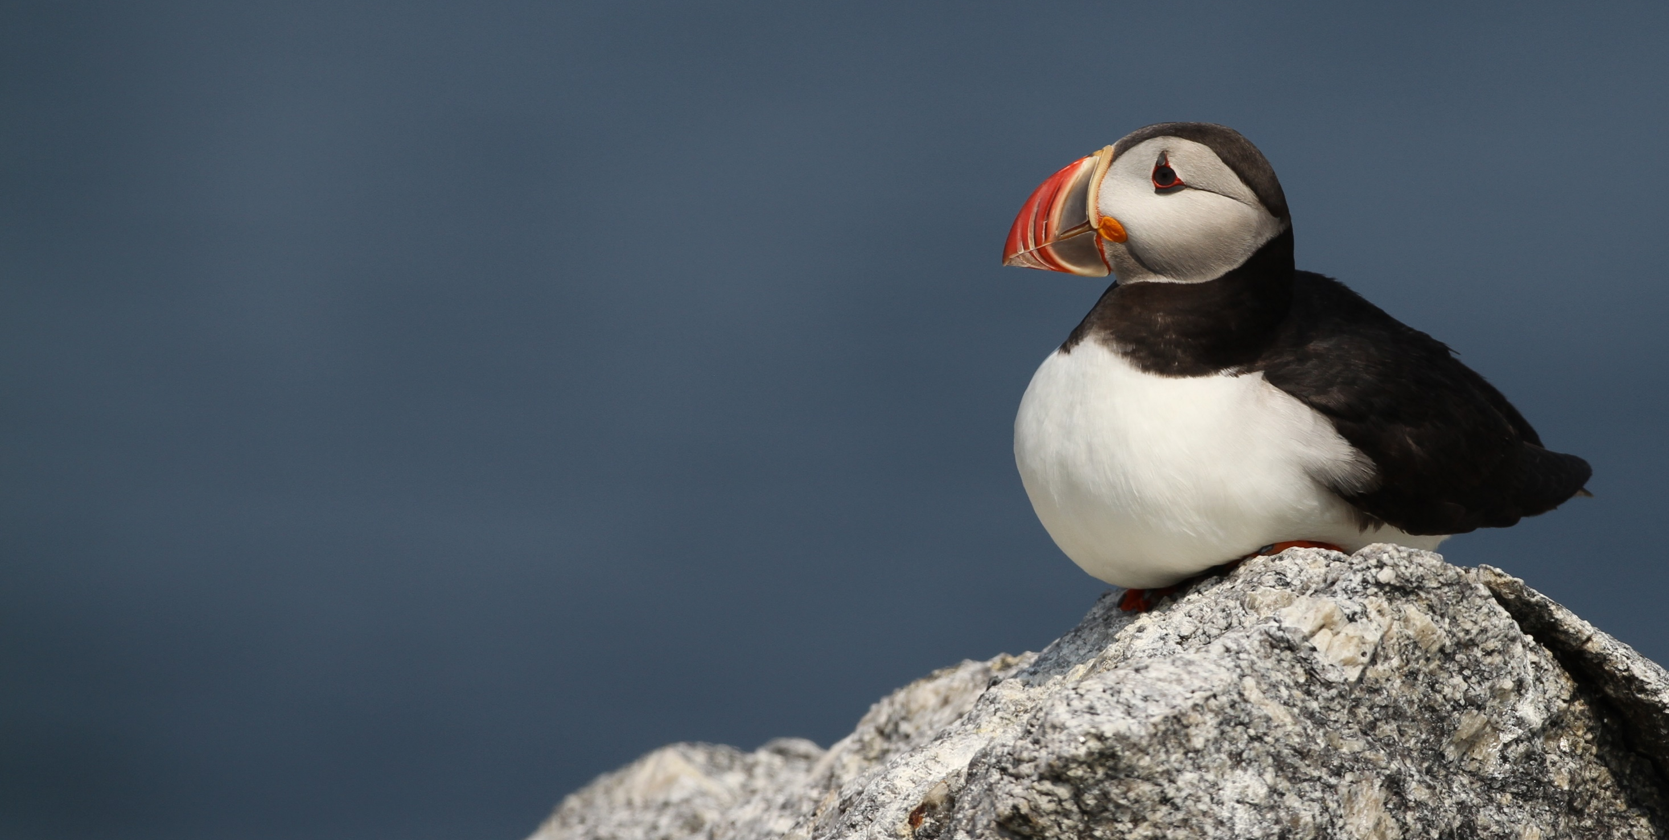
Differential Response of Gulf of Maine Seabirds to the 2018 Ocean Heat Wave
Differential Response of Gulf of Maine Seabirds to the 2018 Ocean Heat Wave
Don Lyons
Steve Kress
Paula Shannon
National Audubon Society
Seabird Restoration Program
S. Kress

Slide 2


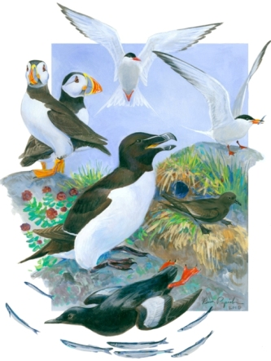




Gulf of Maine
Seabird Working Group (GOMSWG)
Ram Papish

Slide 3
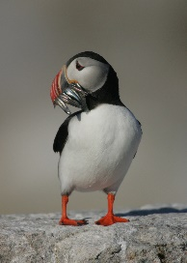
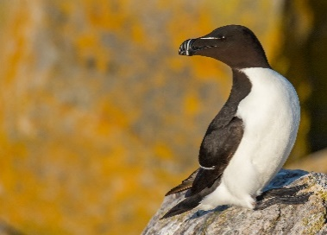
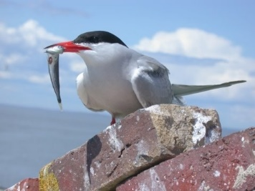

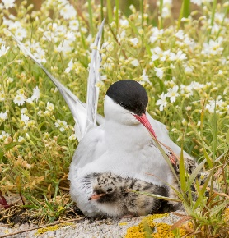
Study Colonies and Species
        Matinicus Rock:
          Atlantic Puffins
          Razorbills
          Common Terns
          Arctic Terns
Buoy E01
Matinicus
Rock
B. Scholtz
J. Hall
S. Kress
J. Hall
E. Rowarth and R. Signell, USGS

Slide 4
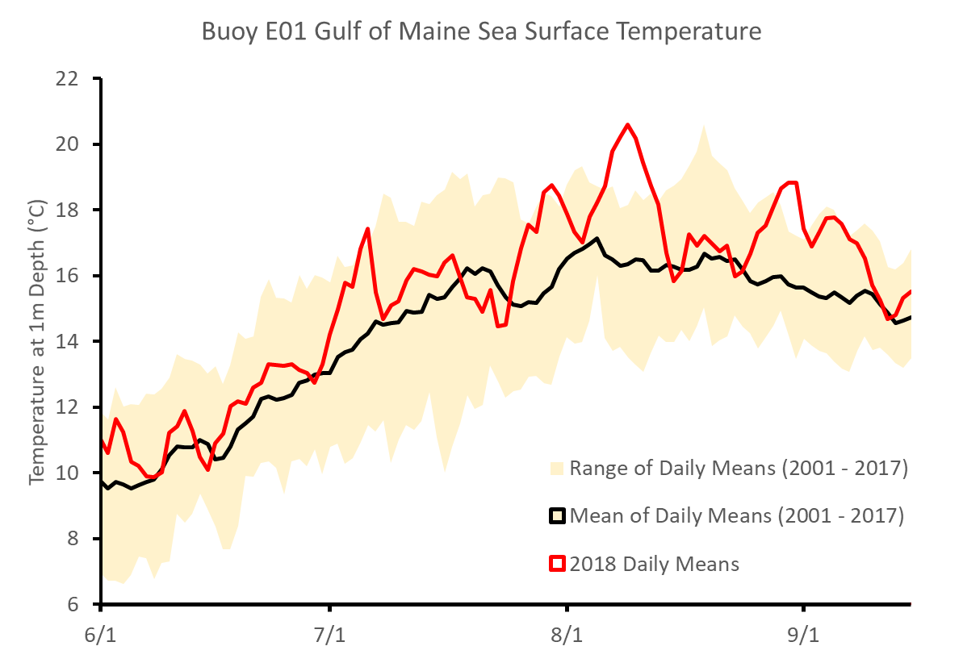
Another warm summer in the Gulf of Maine
  “Ocean Heat Wave”:
        Pulses of warming
        Record SST in early August

Slide 5
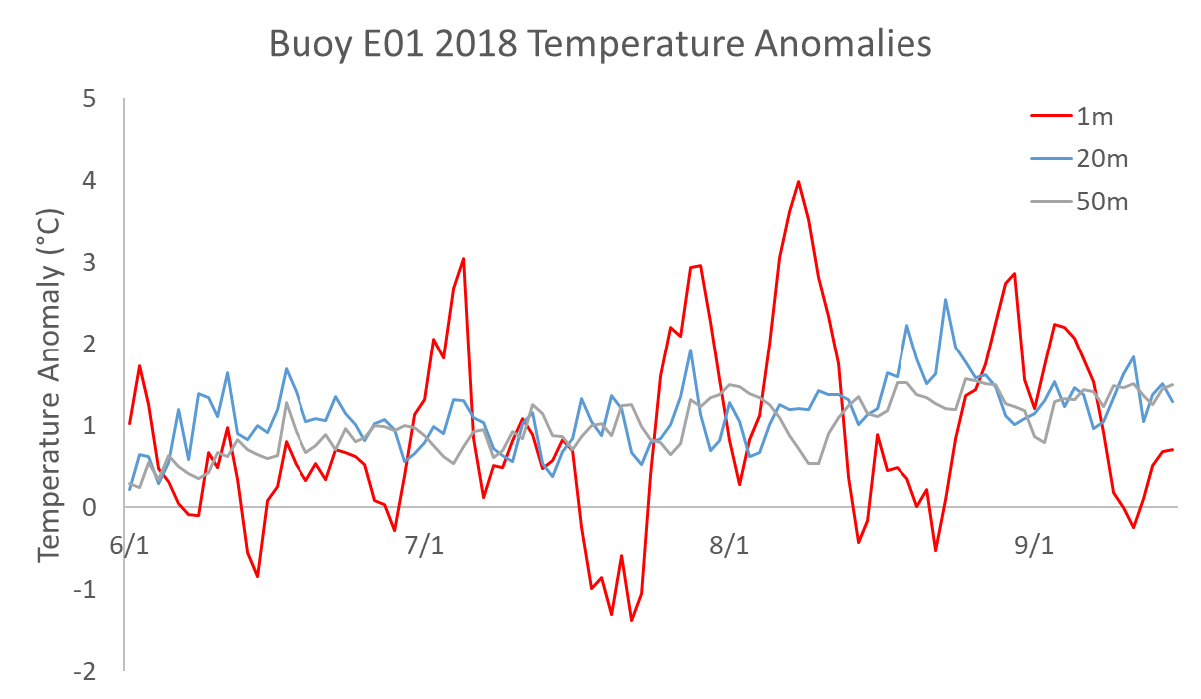
Another warm summer in the Gulf of Maine
  “Ocean Heat Wave”:
        Pulses of warming
        Record SST in early August
        Warm throughout water column but particularly at surface
        Extended warming 7/24 – 8/13
        Greatest warming occurred when most puffins typically fledge

Slide 6
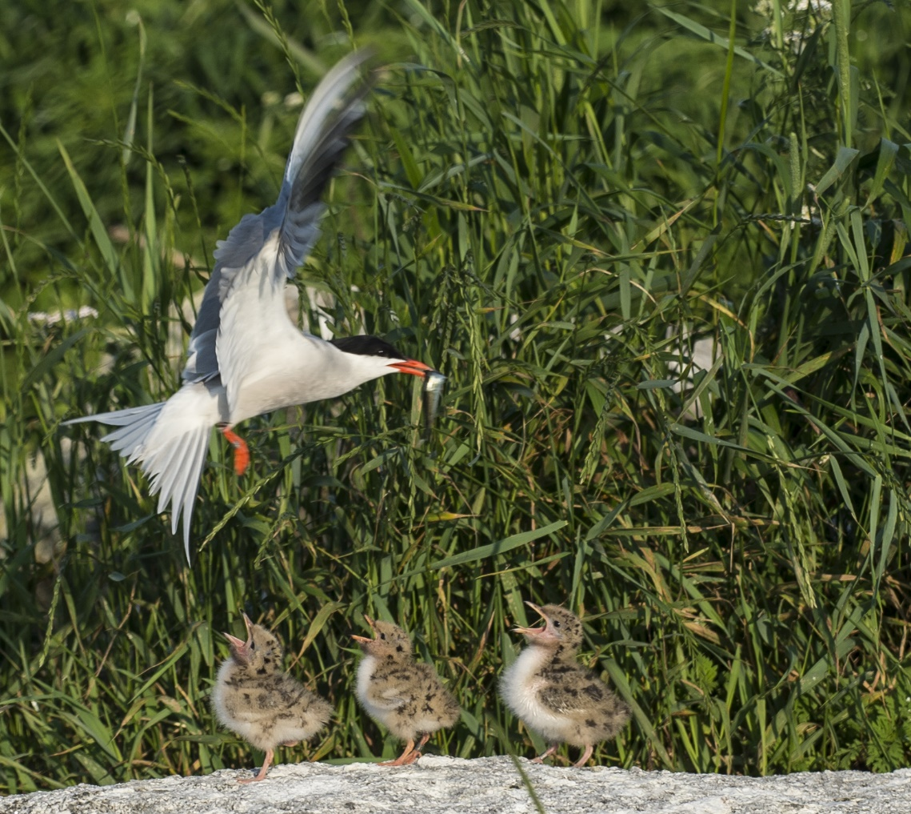
Results Outline
  For all species, consider
      Phenology
      For puffins, consider
      Diet
      Chick feeding and growth rates
      Ultimate measure:
      Chick productivity
S. Flint

Slide 7
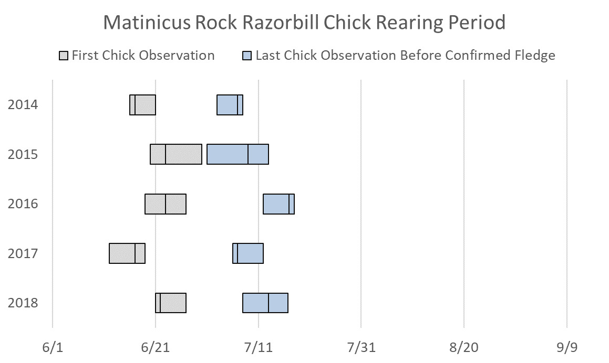
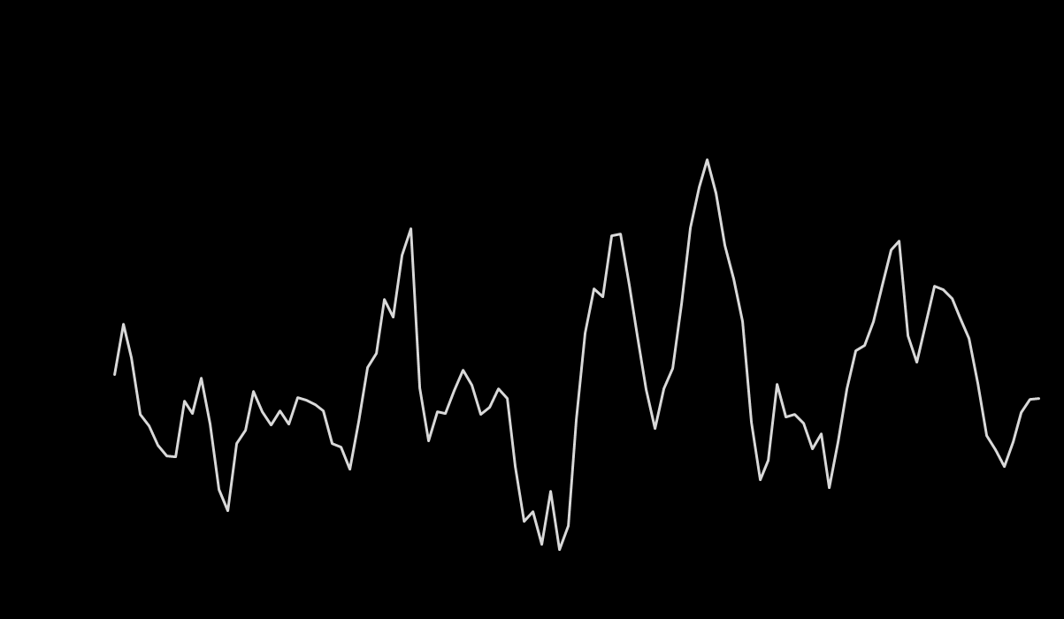
2018 Razorbill Phenology at Matinicus Rock
        Nest checks at sample nests occur every 3-5 days across season
        No overlap with extended heat wave in late July and early August
J. Hall

Slide 8
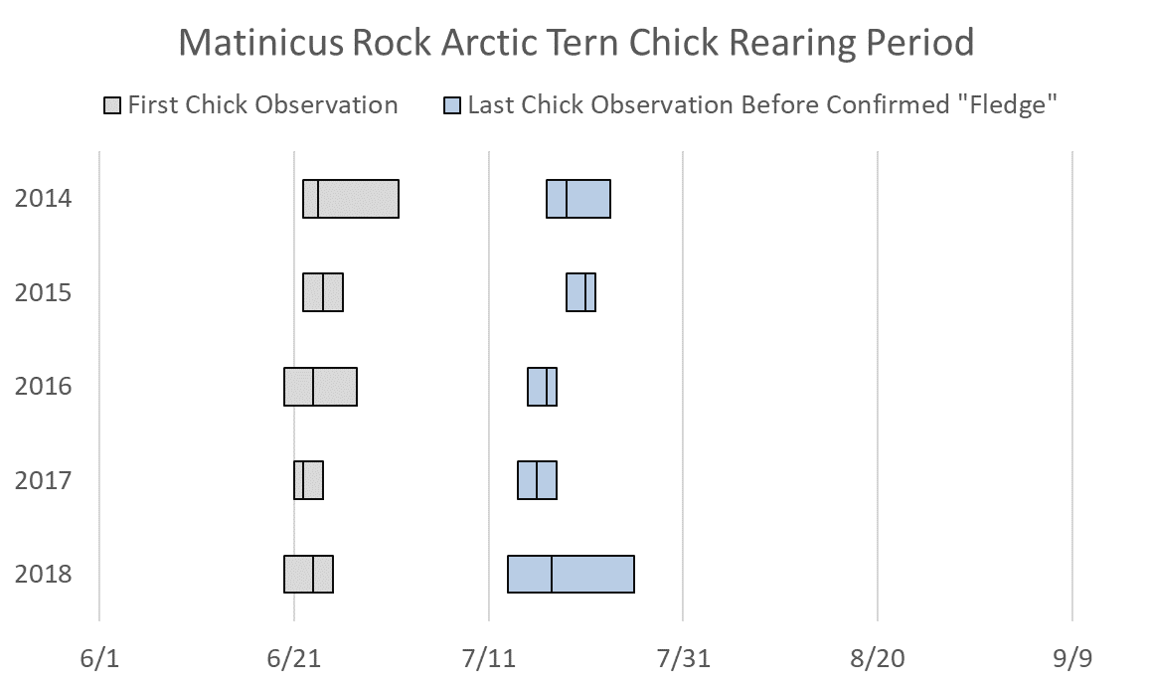
2018 Arctic Tern Phenology at Matinicus Rock
        Nest checks at sample nests occur every 1-3 days across season
        Potential overlap with extended heat wave in late July
J. Hall

Slide 9
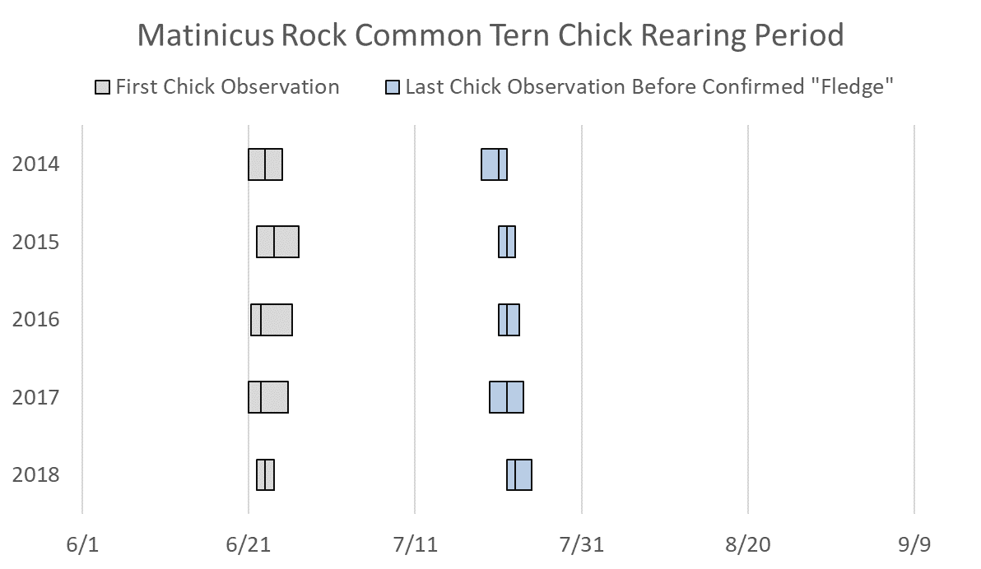
2018 Common Tern Phenology at Matinicus Rock
        Nest checks at sample nests occur every 1-3 days across season
        Overlap with extended heat wave in late July
S. Kress

Slide 10
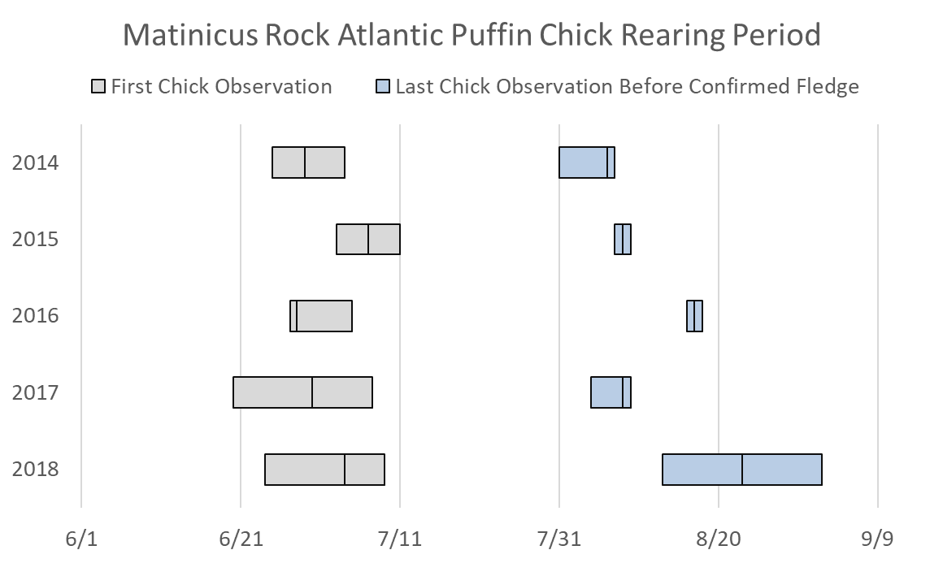
2018 Puffin Phenology at Matinicus Rock
        Nest checks at sample nests occur every 3-5 days across season
        Overlap with extended heat wave in late July and early August
        Most extended breeding season since puffin restoration!
B. Scholtz

Slide 11
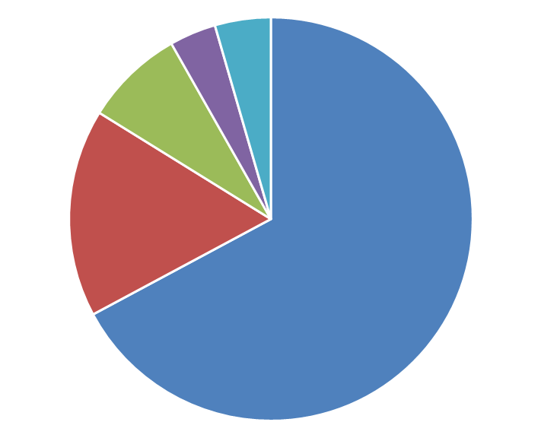
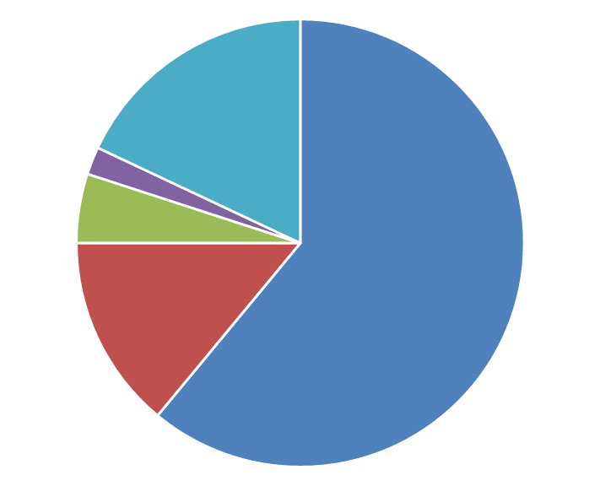
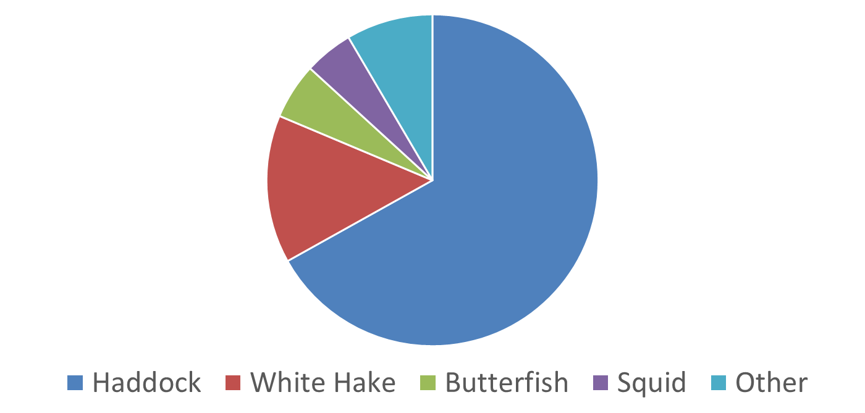
2018 Matinicus Rock Puffin Diet
June 23 – July 23
(before heat wave)
July 24 – August 8
(during heat wave)
B. Scholtz
Herring
Pollock
Sandlance
Others

Slide 12
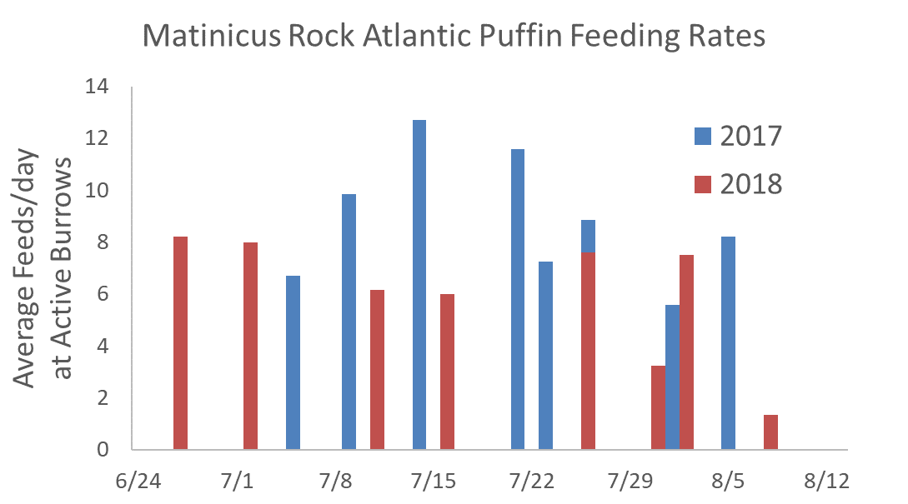
2018 Puffin Feeding Rates at Matinicus Rock
        Feeding rates were lower in 2018 than in 2017
        Low rates proceeded warmest period, but lowest rates during warm period
B. Scholtz

Slide 13
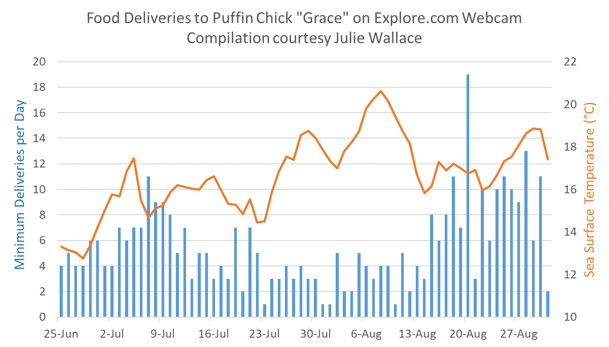
2018 Puffin Feeding
Rates at Seal Island
        Intensively monitored Webcam nest exemplifies larger pattern
        Feeding rates rebounded later in season when waters cooled
B. Scholtz

Slide 14
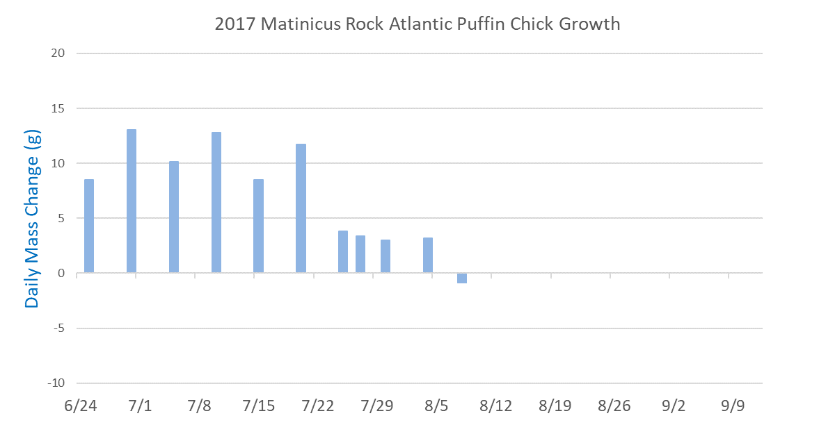
Typical Puffin Growth Patterns
        Initially high growth rates (~10g/day)
        Growth plateaus as chick approaches fledging age
B. Scholtz

Slide 15
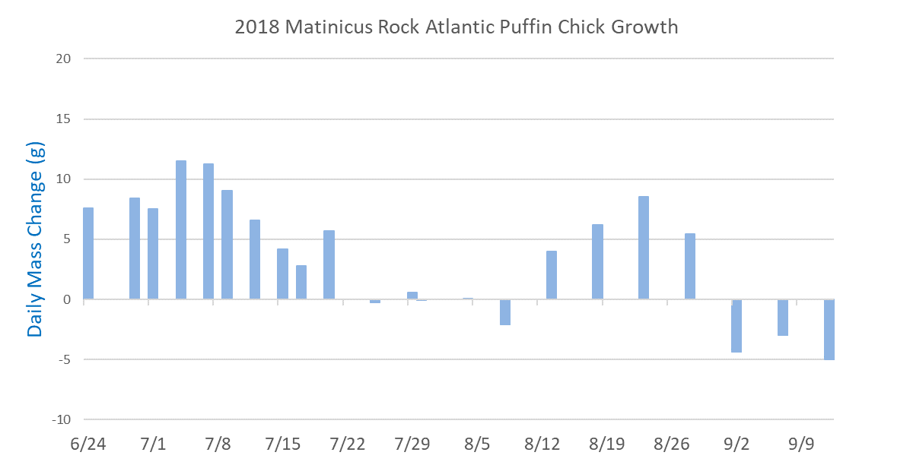
2018 Puffin Growth at Matinicus Rock
        Lower initial growth rates than 2017 (<10g/day)
        No growth during late July and early August, significant chick mortality
        Compensatory growth spurt in survivors during much of August
        Many chicks fledged after extended rearing period

Slide 16
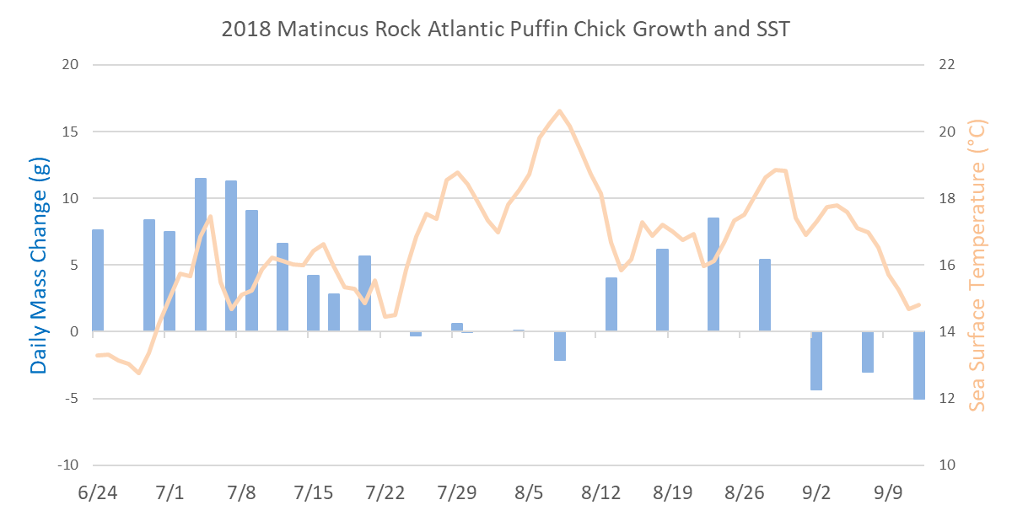
2018 Puffin Growth at Matinicus Rock
        Growth stalled at onset of warmest conditions
B. Scholtz

Slide 17
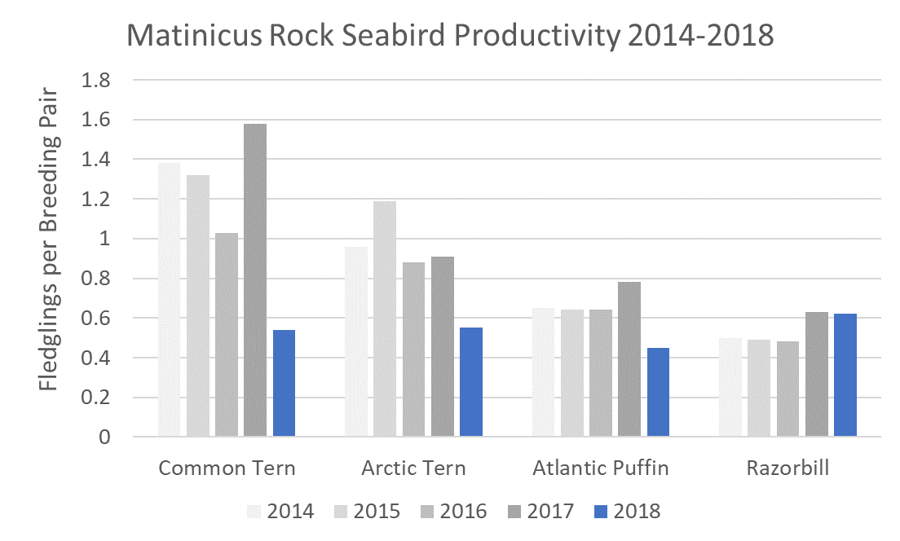
Seabird Productivity at Matinicus Rock
        Tern productivity significantly lower than recent years
        Puffin productivity down moderately
        Razorbill productivity near highest recorded levels

Slide 18
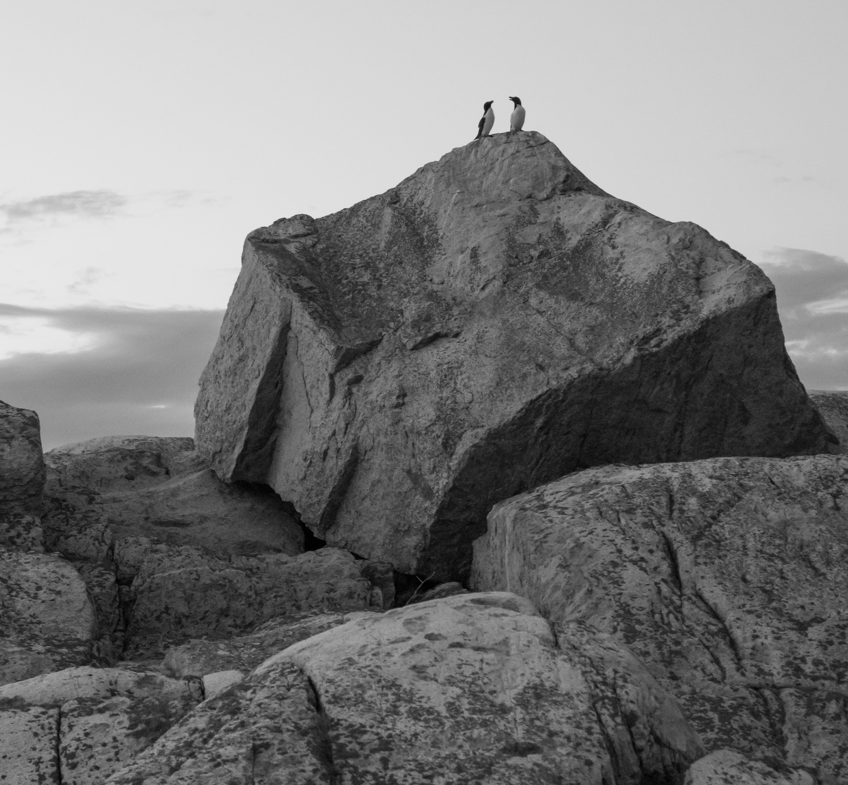
Conclusions
  Razorbills resilient
      Efficient diver
      Earliest fledge
      Terns challenged
      Surface feeder
      Heat wave occurred near end of rearing period
      Puffins intermediate?
      Capable diver
      Generalist predator
      Optional slow chick growth and extended chick rearing
J. Hall

Slide 19
Conclusions
  Variable seabird response to heat wave
      Timing and duration of extreme events can determine survivors, losers
      Unexpected behavioral and physiological plasticity may be helpful
      Long term impacts of delayed development unclear, however
      Response during unobservable post-fledging period is still largely unknown
J. Hall

Slide 20
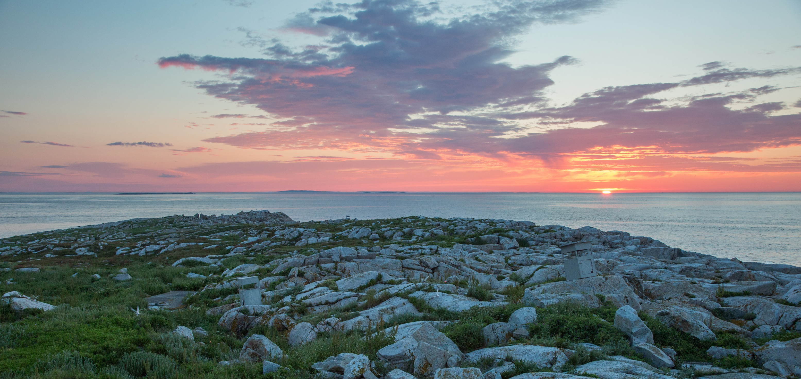
Questions?
  skress@audubon.org
  @don_e_lyons
  projectpuffin.audubon.org
J. Hall

