Slide 1

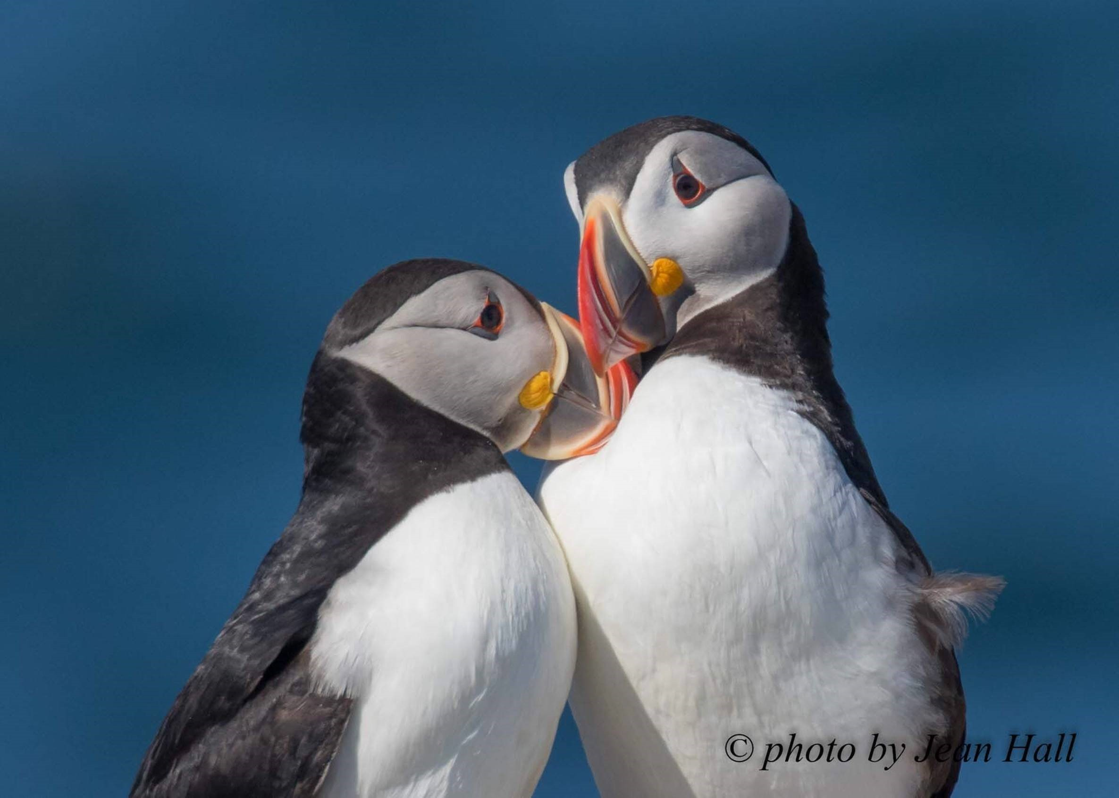
Seabird Advisory Council
Annual Meeting – 20 August 2016

Slide 2
Agenda
9:00 Introductions
9:30 Audubon Science
- Gary Langham, VP and Chief Scientist
9:45 FY 2016 Seabird Restoration Program Highlights: Science, Outreach and Finance
- Steve Kress, VP and Executive Director SRP
10:45 Update to Audubon Strategic Plan: Coasts
- David O’Neill, Senior Vice President, Conservation
11:00 Feasibility Study Review and Future Planning
12:00 Lunch

Slide 3
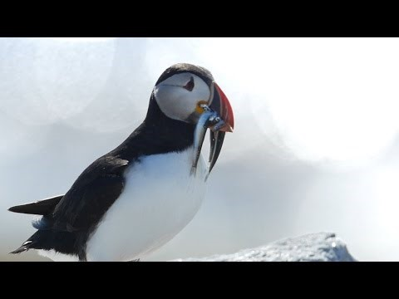

Slide 4
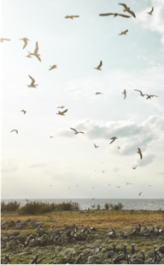
Audubon’s work will focus on the most important breeding, stopover, and wintering sites for birds in each flyway throughout the hemisphere.
COASTS
Strategic Priorities
2016-2020

Slide 5
Increase the populations of 16 flagship species at 500 priority sites.
Enlist 10,000 volunteers and partners with 130 Audubon chapters for beach stewardship.
COASTS
Goals

Slide 6
Seabird Restoration Program
  Advancing the scientific knowledge of applied seabird conservation and safeguarding key Maine island nesting habitats and colonies.
  Education and outreach with Hog Island Audubon Camp, Project Puffin Visitor’s Center, and intern program as key components
  Cultivating diverse funding sources to support core costs
COASTS
Seabird Restoration Program
READINESS
CAPACITY
RESULTS

Slide 7
Highlights of 2016
Seabird Restoration Program

Slide 8
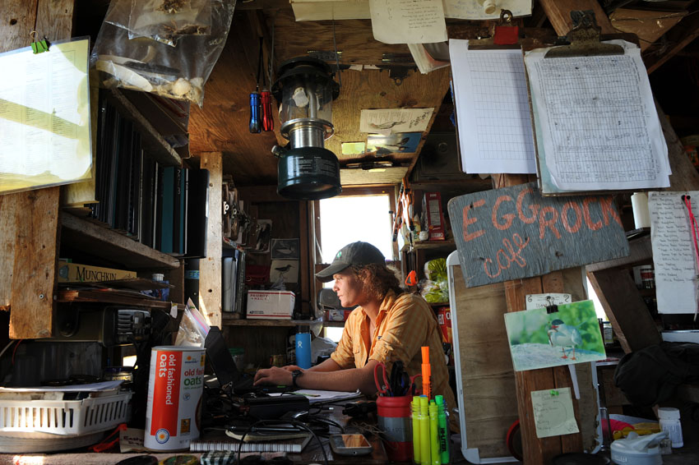
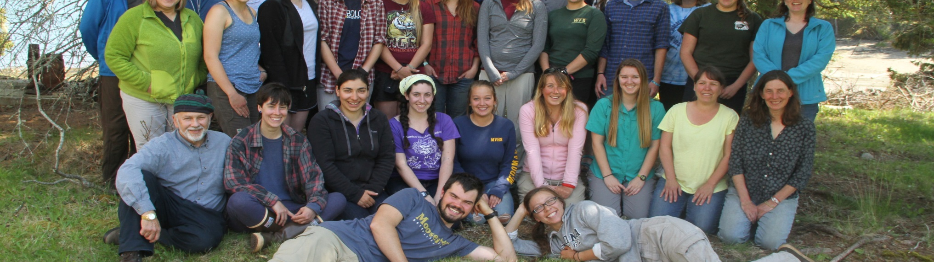
2016 Seabird Restoration Program Staff & Interns
  10 full time staff
  11 research assistant interns (Bowdoin, Colby, Hobart and William Smith, Texas A&M)
  8 island supervisors
  3 International fellows
  2 education assistant interns
  2 part time
  6 seasonal
  20 volunteers

Slide 9
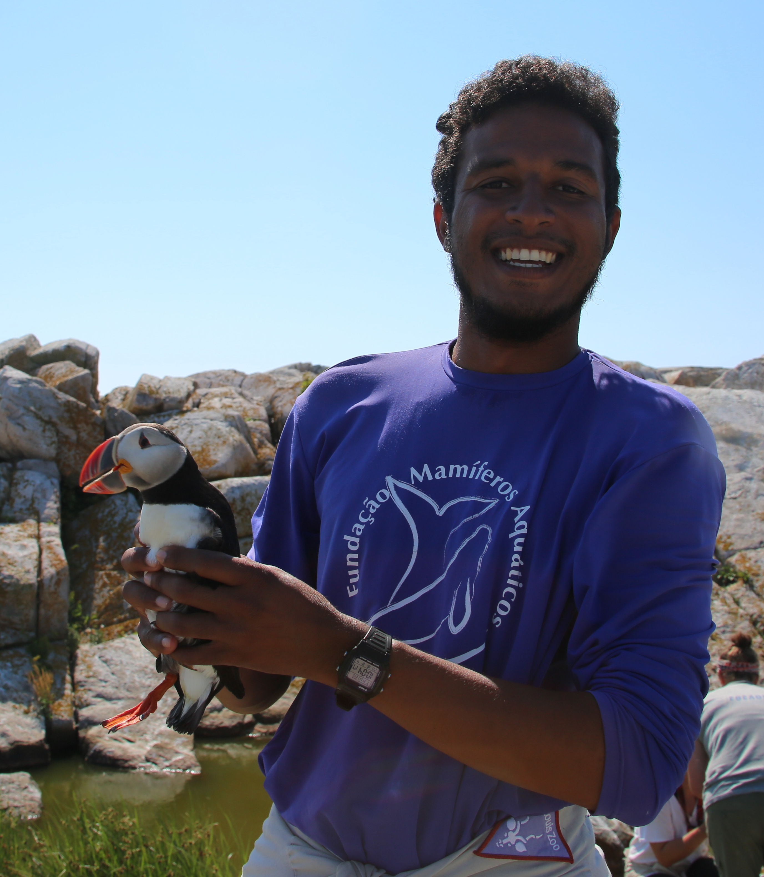
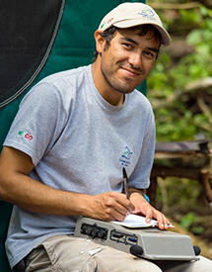
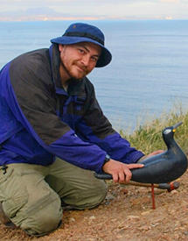
2016 Josephine Herz International Fellows
  Jonathan dos Santos
    Veterinary Medicine Degree (FPD/SE), College Pio Decimo, Brazil
    Interned at Foundation for Aquatic Mammals investigating causes of marine mammal stranding.
  Fernando Solis
    BSc Biology, Universidad Autonoma de Nuevo Leon, Mexico
    Worked for Grupo de Ecologia y Conservacion des Islas preserving the flora and fauna of Mexican Islands.
  Miguel Corrales
    BSc Biology, Universidad Autonoma de Sinaloa, Mexico
    Worked for Grupo de Ecologia y Conservacion des Islas

Slide 10
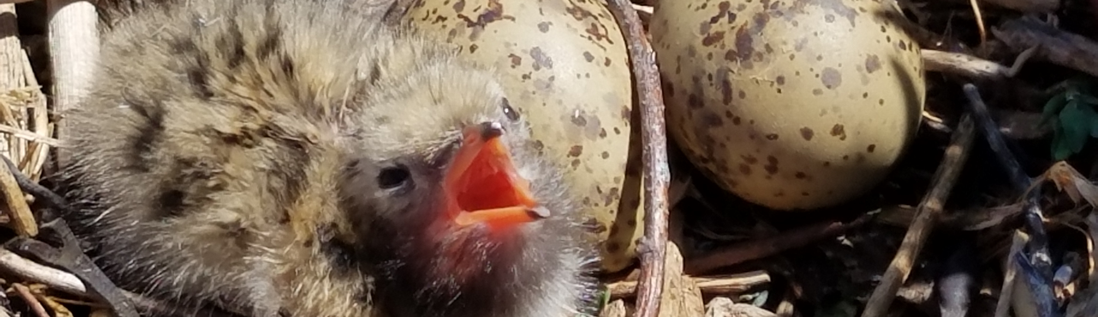
2016 Seabird Overview
  Season started with plentiful food and large clutch sizes.
  Weather events and food drop-off in July affected chick health.
  Kleptoparasitism from Laughing Gulls is increasing problem.
  Predation and invasive plant species continue to be issue.

Slide 11
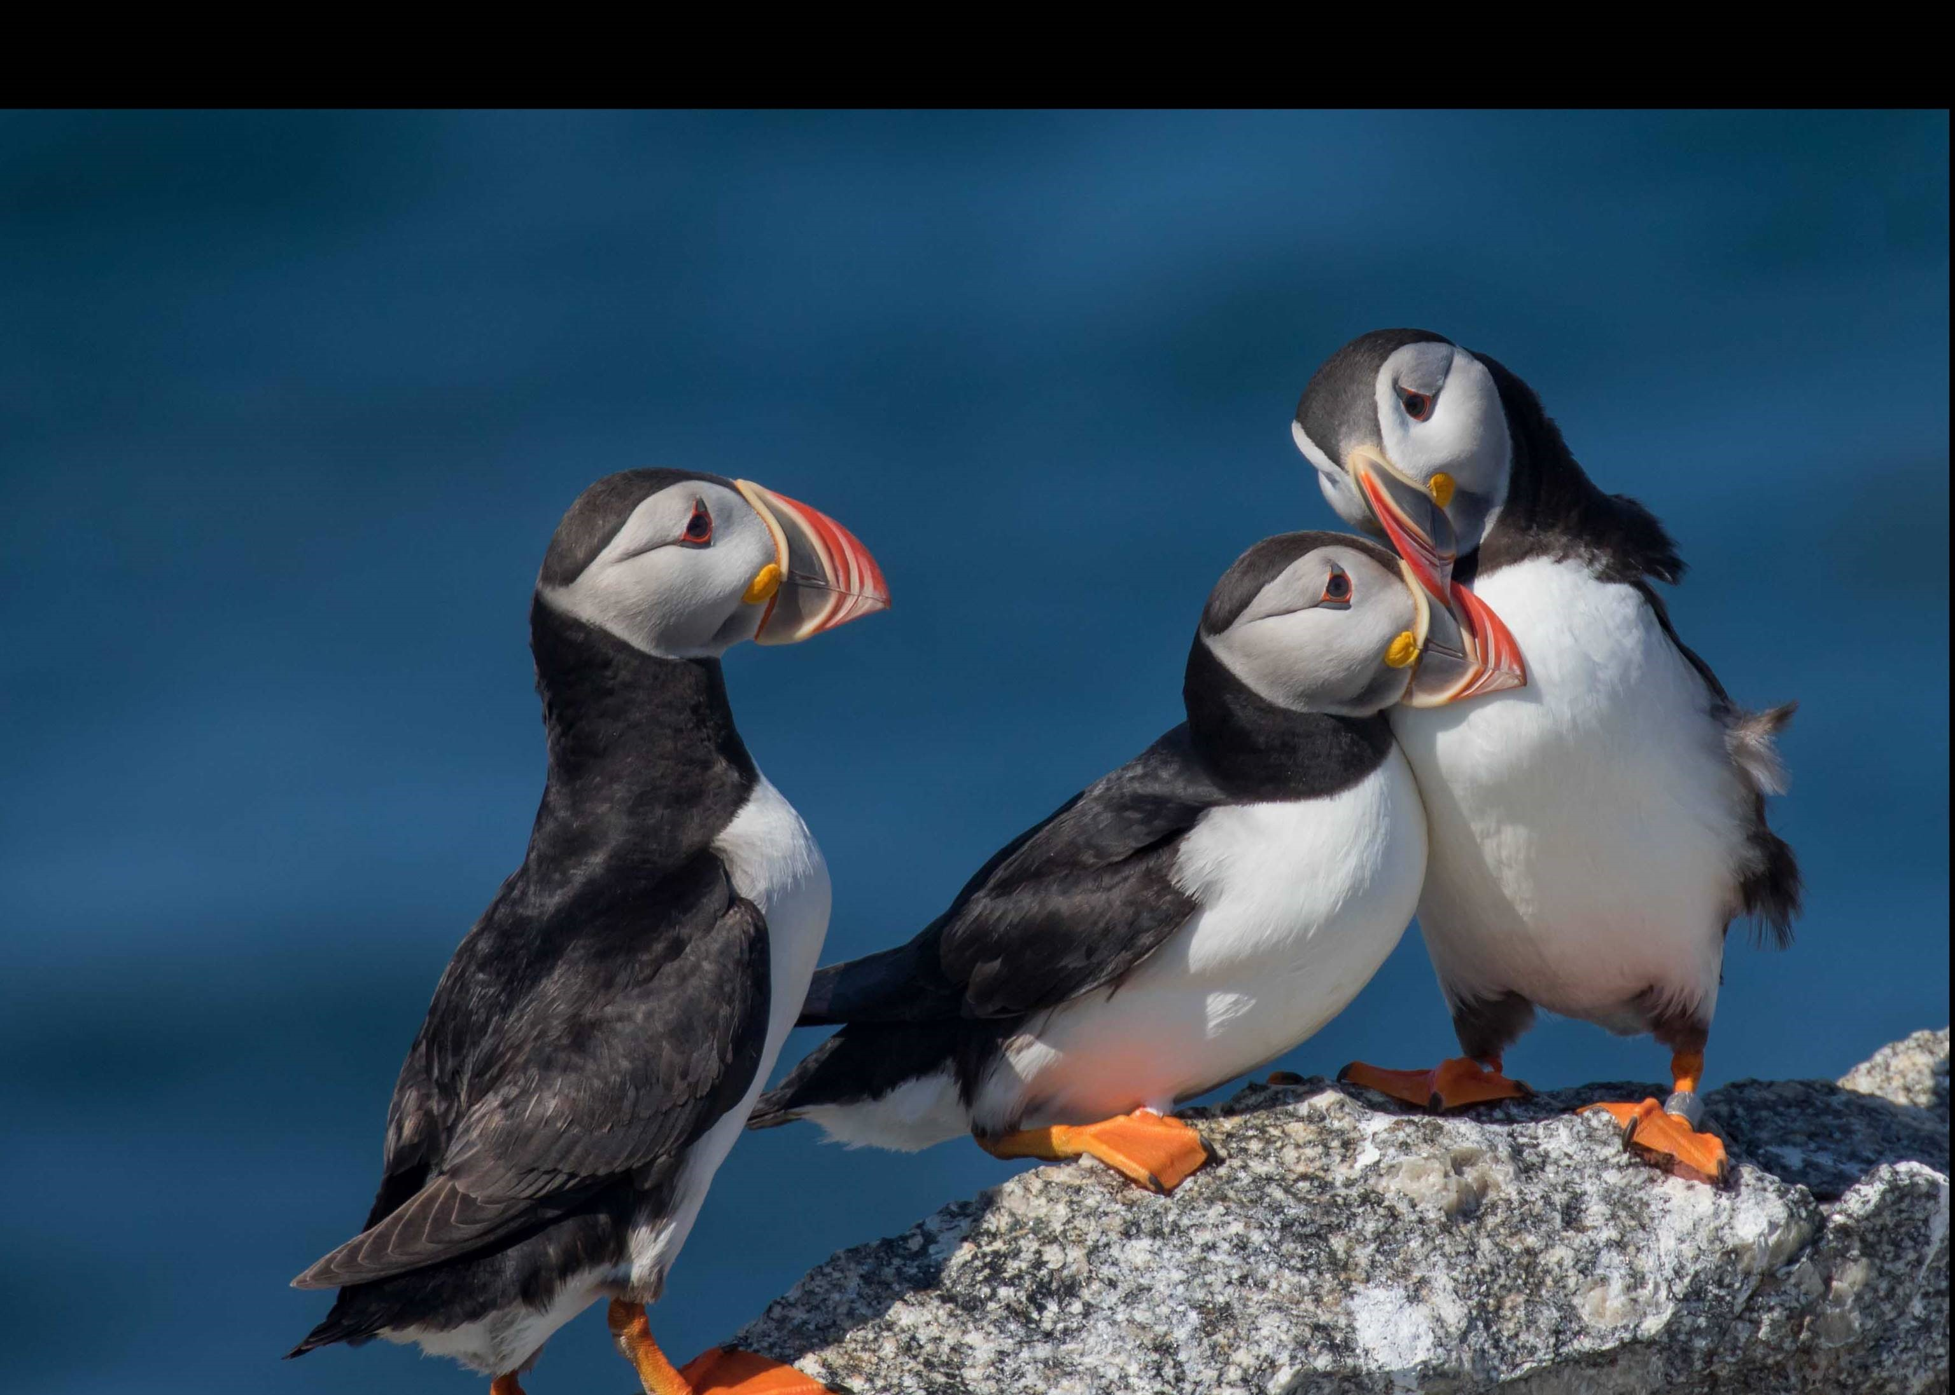
Our Seabird Science
2016 Findings

Slide 12
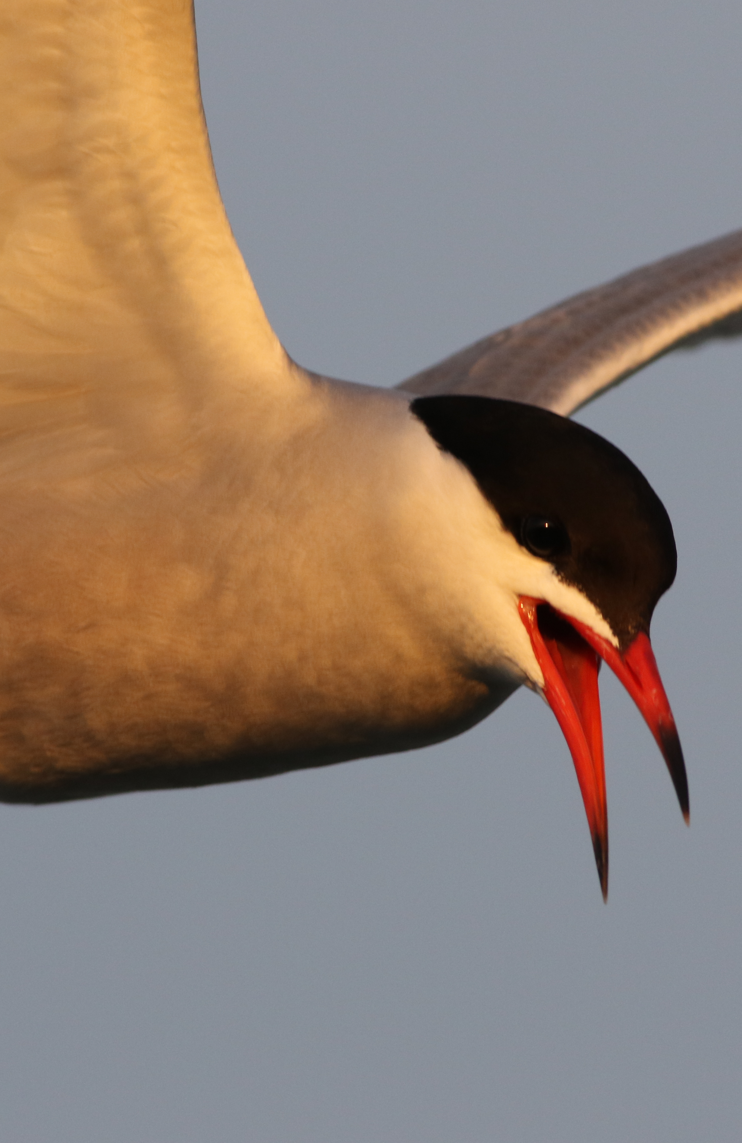
Common Tern
  Estimated 6415 active nests on all 7 research islands
  White Hake, Sand Lance, Herring and Euphausiid most prevalent in diets (island dependent)
  Success of Common Tern colonies are crucial to conservation of Roseate Terns

Slide 13
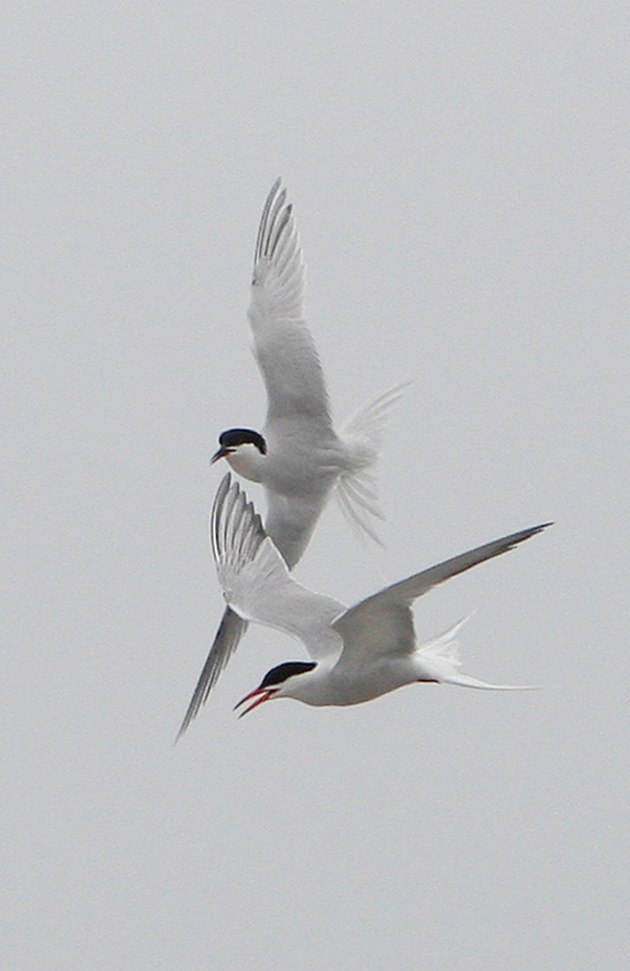
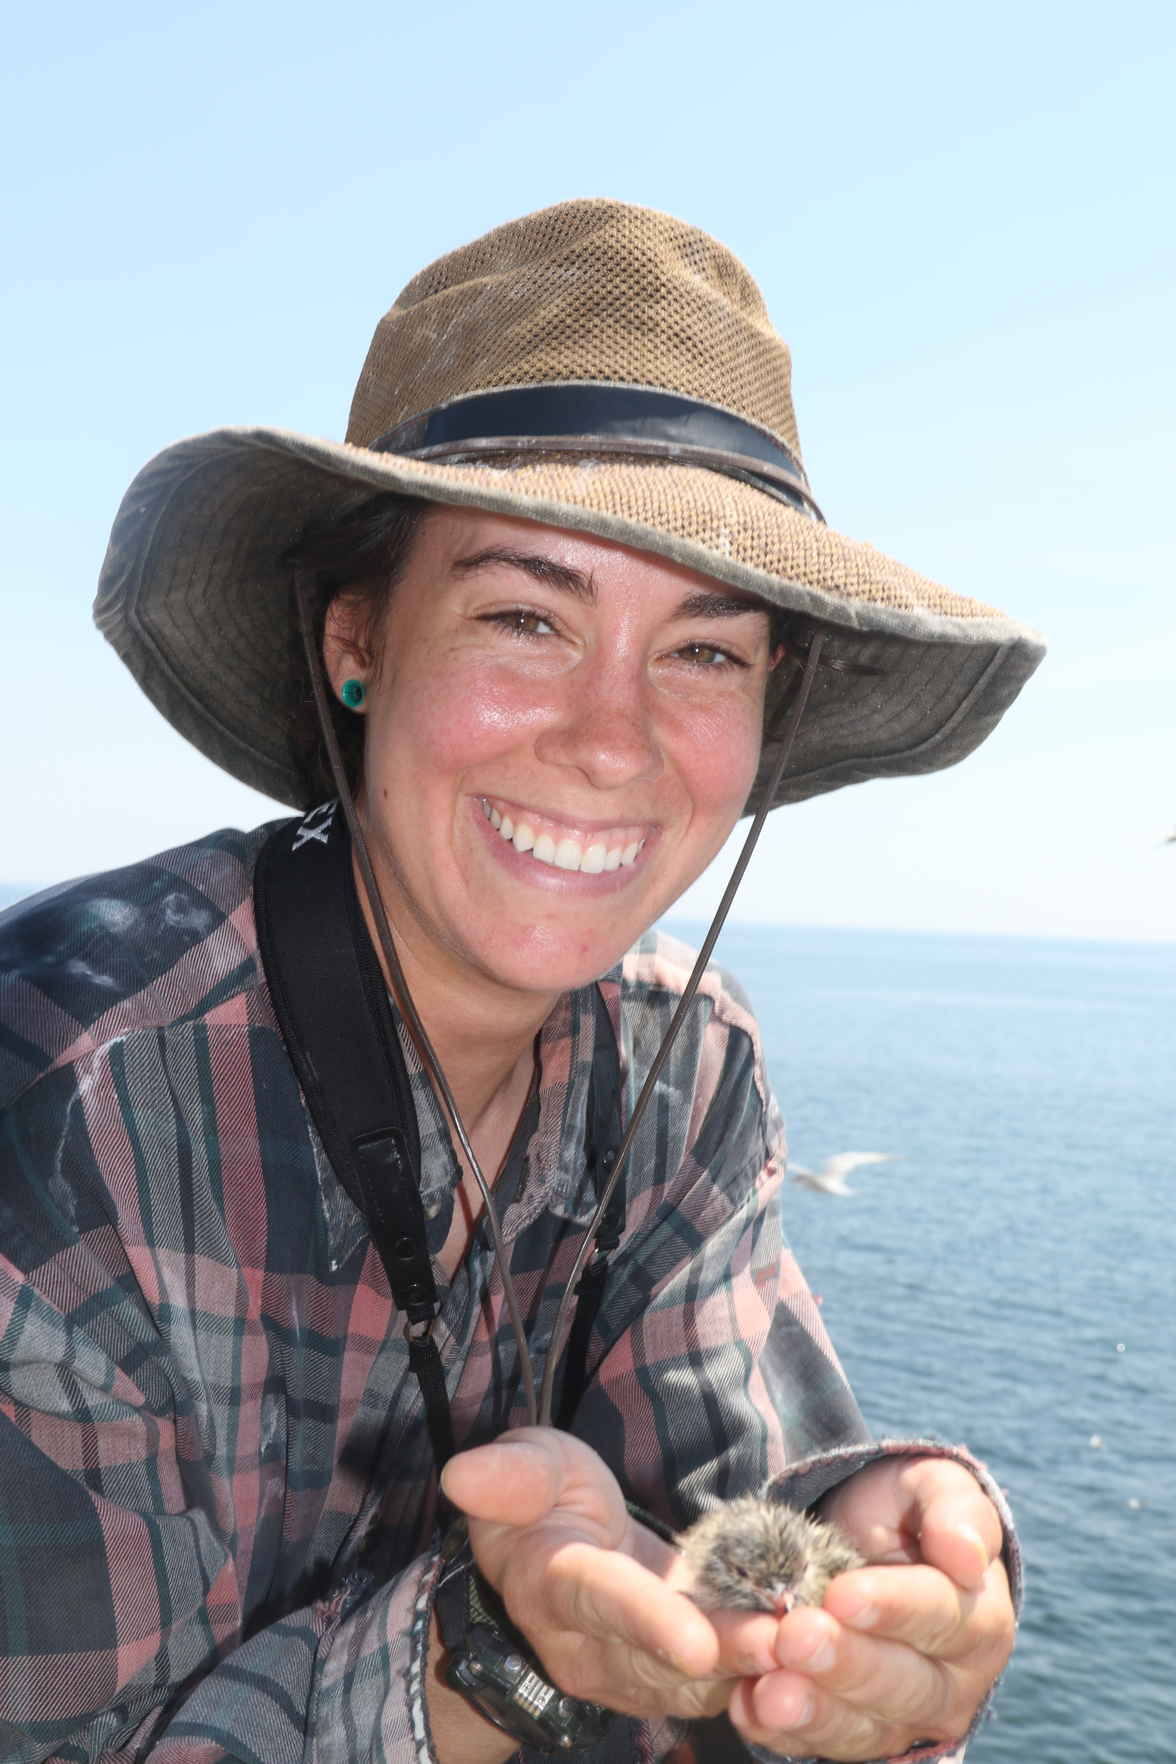
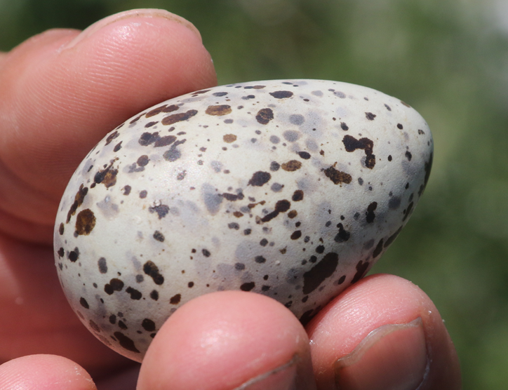
Roseate Tern
  One of Audubon’s 16 target species in Coasts Program
  Estimated 182 active nests on 5 research islands
  Sand lance and white hake were most prevalent in diets (island dependent)
  A Roseate Tern successfully hatched on Outer Green Island for 1st time since 2010

Slide 14
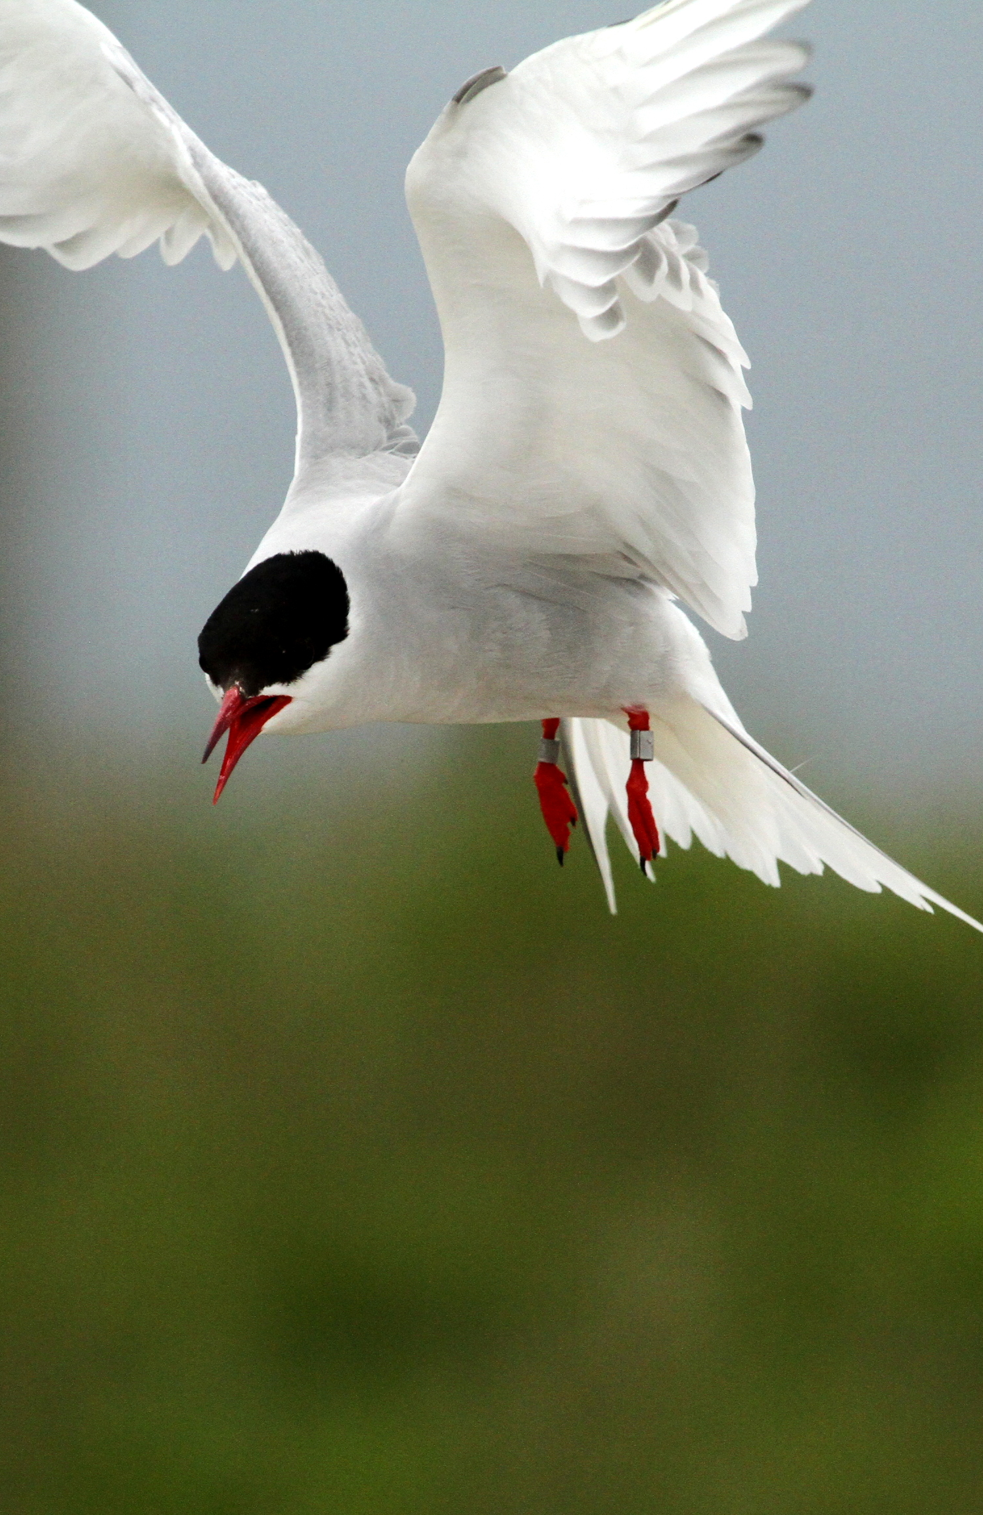
Arctic Tern
  Estimated 1656 active nests on 5 of the research islands
  White hake and euphausiid most prevalent in diet (island dependent)

Slide 16
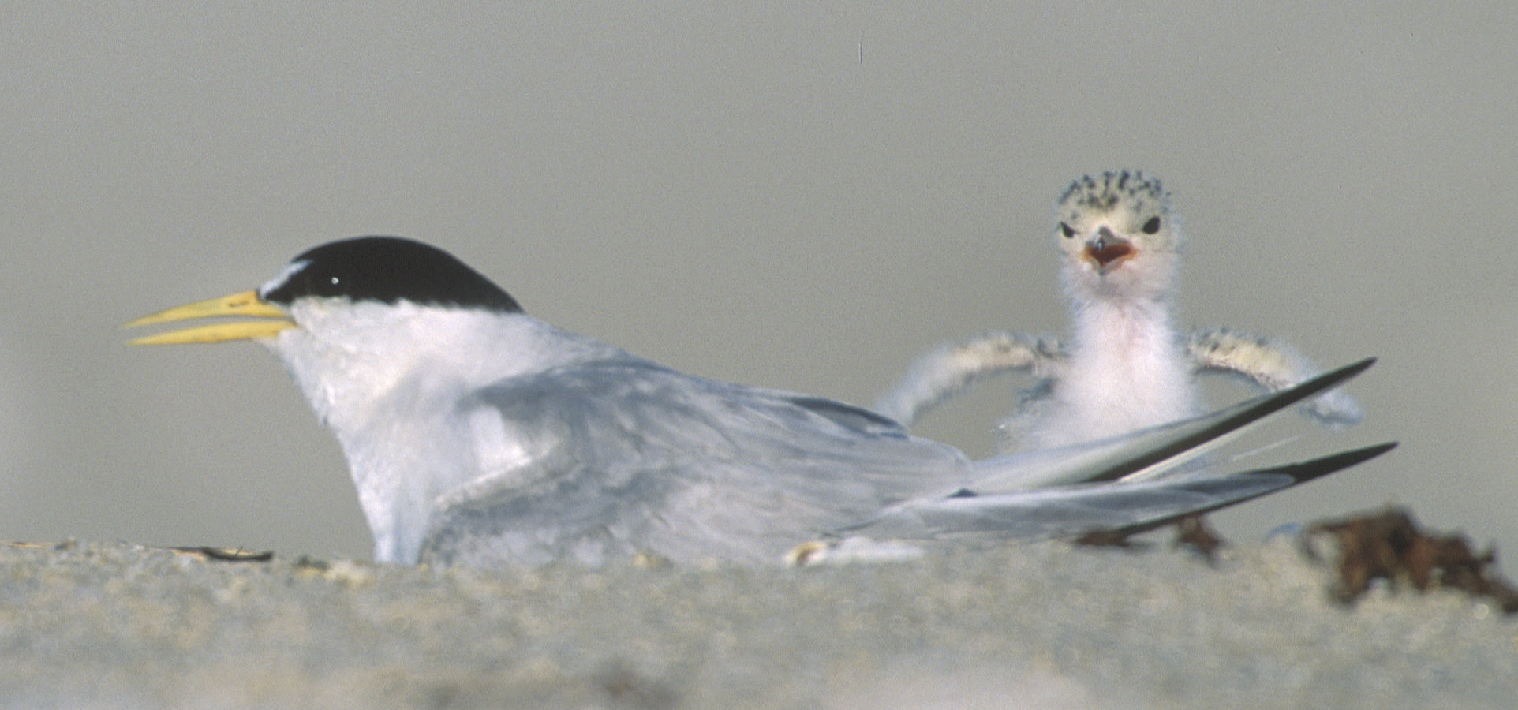
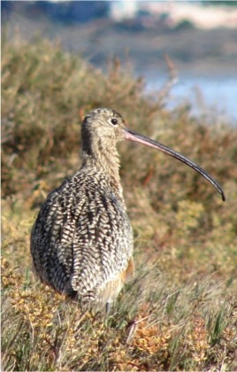
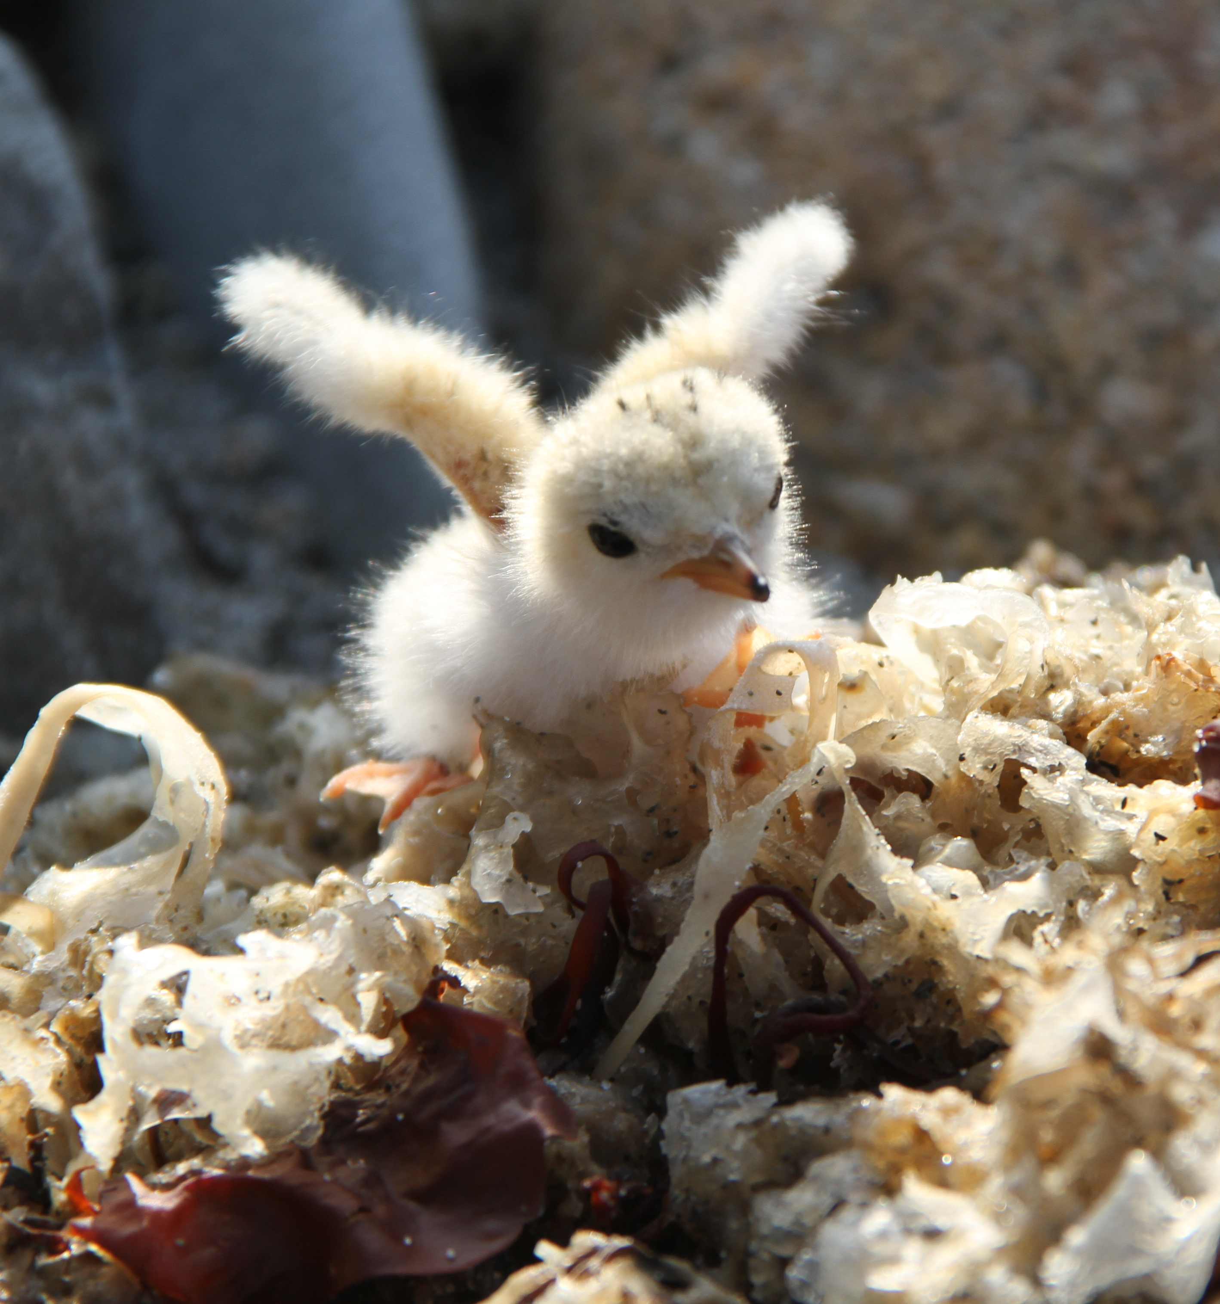
Least Tern
  One of Audubon’s top 7 target species in Coasts Program
  Estimated 69 active nests on Stratton Island
  Northern most limit of range
  Hake and Killifish most prevalent in diet (island dependent)

Slide 17
Atlantic Puffin
  Estimated 1160 active burrows on 3 of the research islands
  Southern most limit of range
  Acadian redfish and haddock greatly increased.
  2014 Geolocator recovered

Slide 19
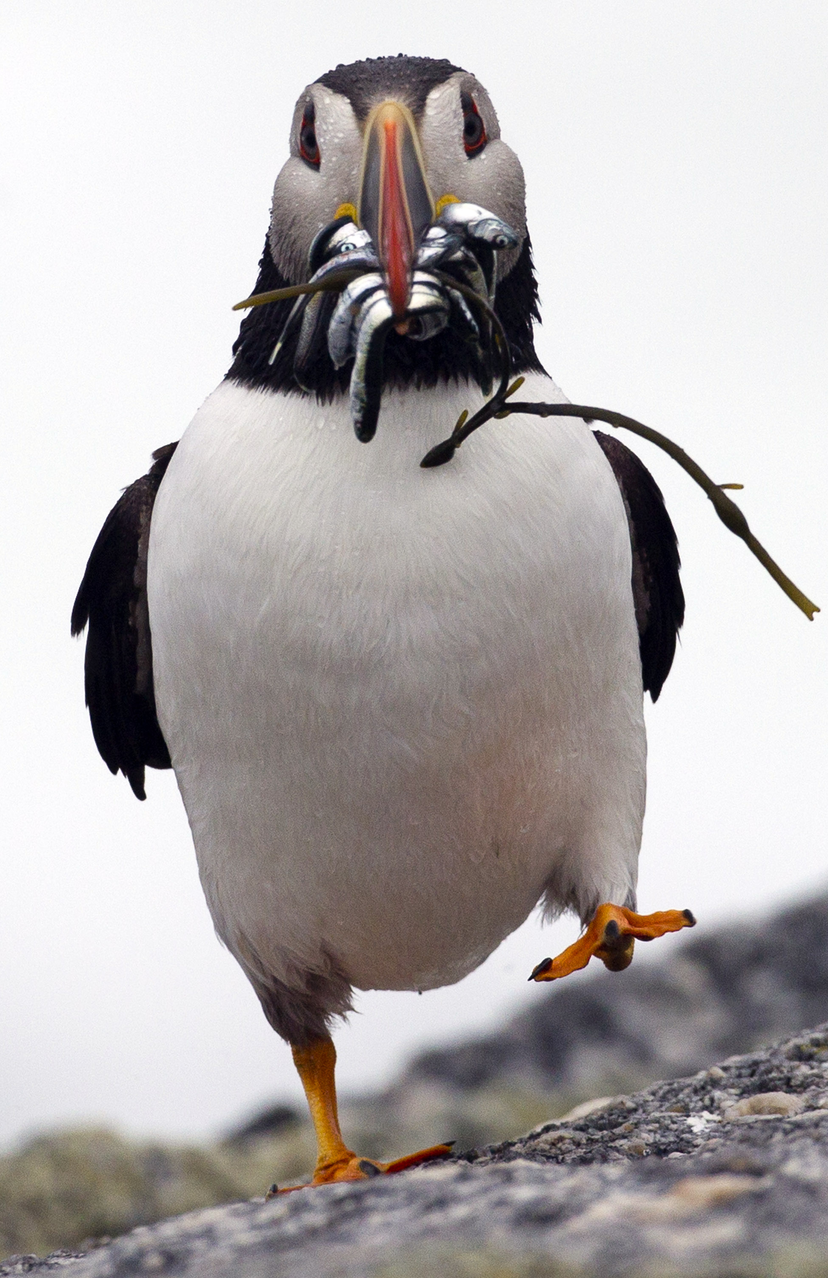
Atlantic Puffin
  Highly variable nesting success between islands.
  Herring was largely absent at all islands.
  White Hake- 76% of chick diet at Seal Island- also junk food.
  Acadian Redfish 43% and 50% of chick diet at Matinicus Rock and Eastern Egg Rock.
  Haddock nearly 10% of diet at Matinicus Rock.

Slide 20
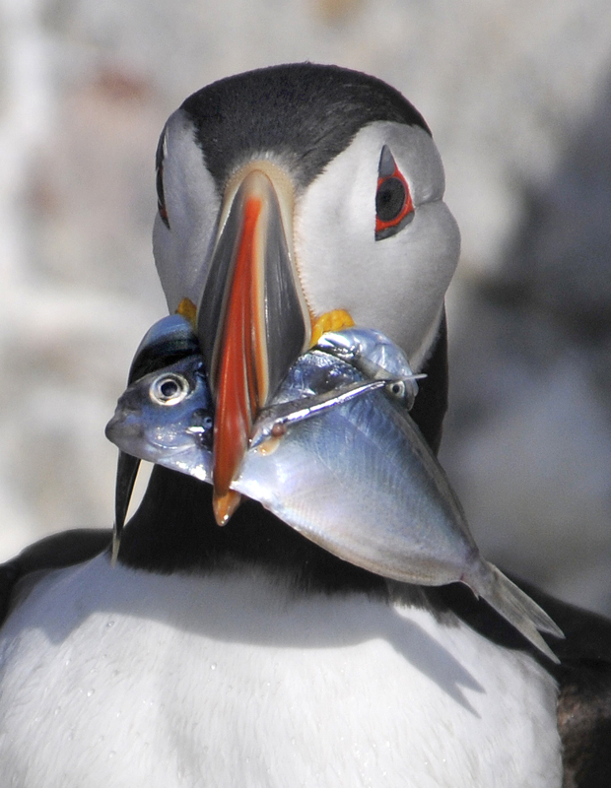
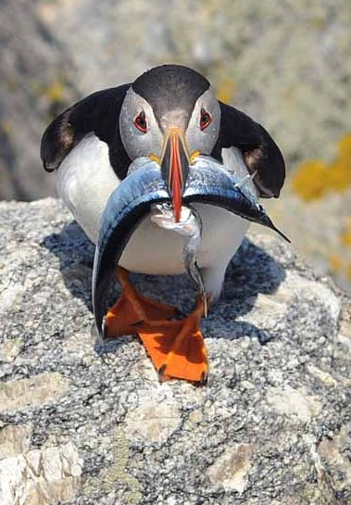
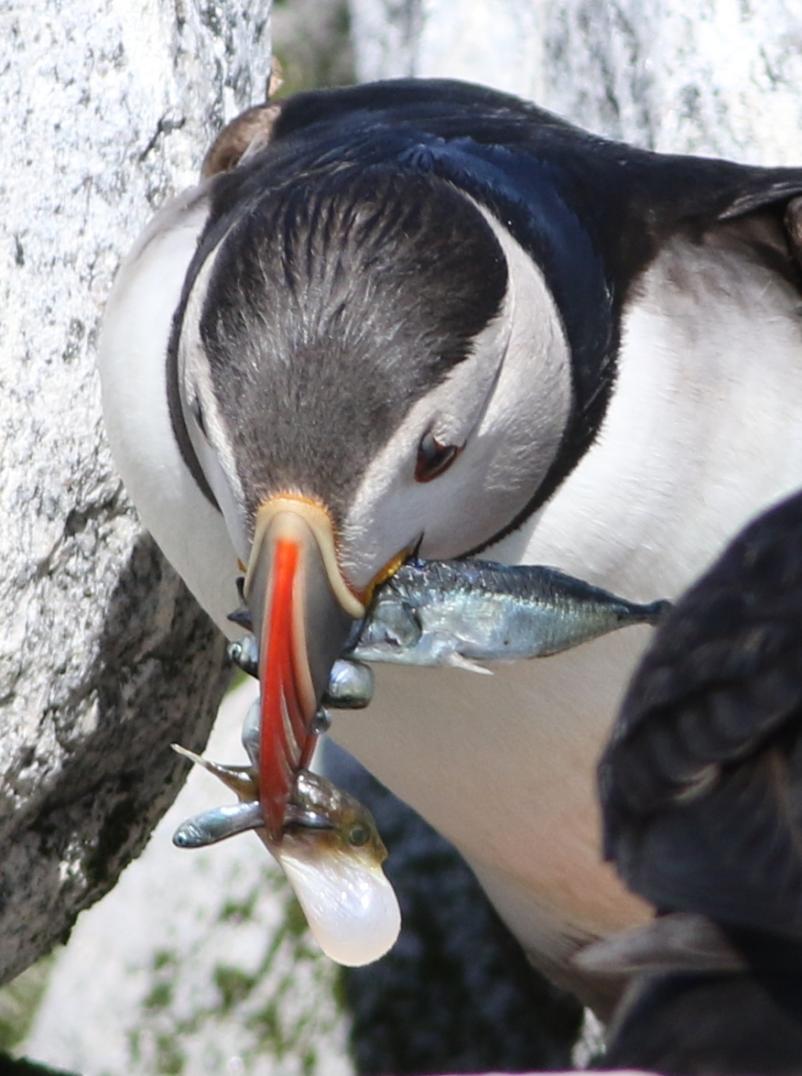
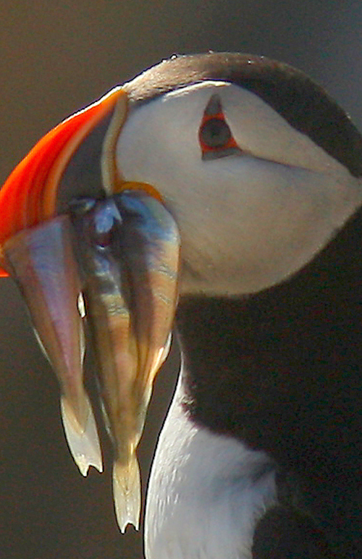
  Seal Island Junk Food
  Butterfish
  Sticklebacks
  Northern Puffer

Slide 21
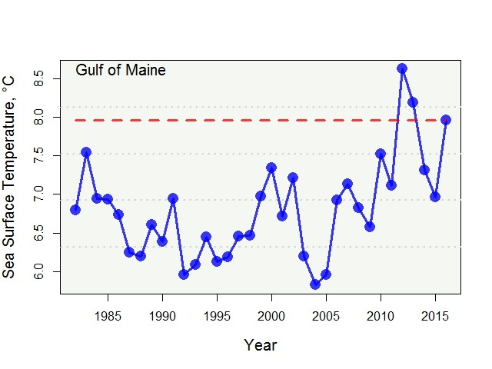
Gulf of Maine
Historic Sea Surface Temperatures
(January-July)
Source: NOAA

Slide 22
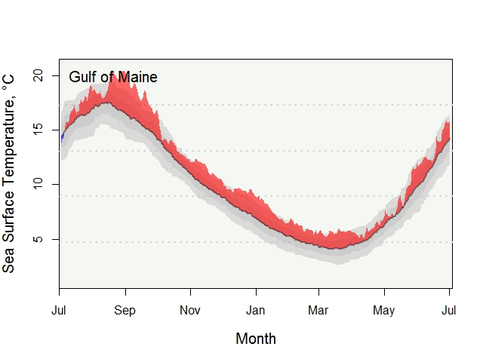
Gulf of Maine
2016 Sea Surface Temperatures
(Compared to mean since 1982)
Source: NOAA

Slide 23
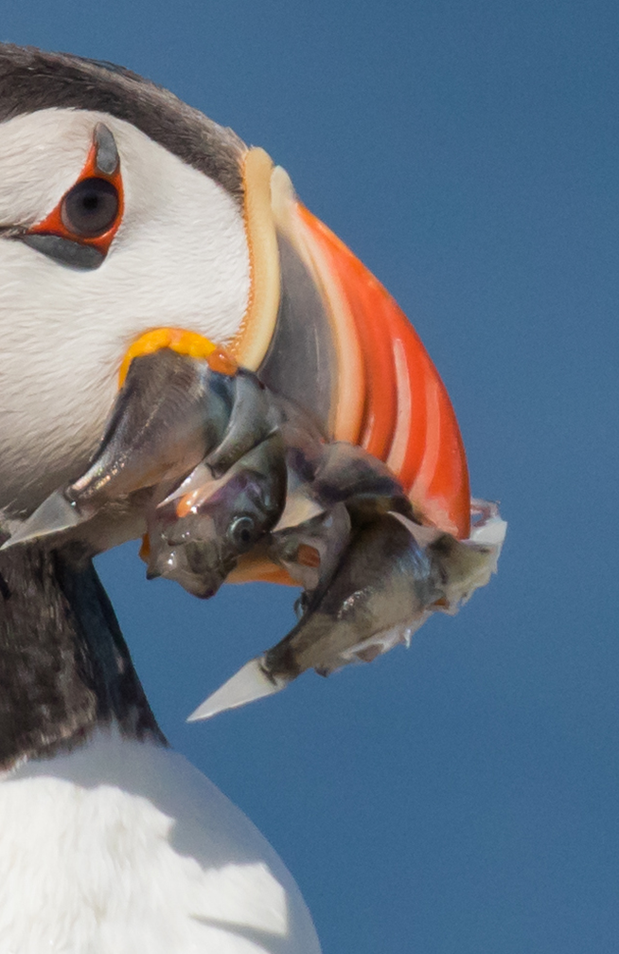
Acadian Redfish
Lives up to 50 years
Live birth of 15-20,000 young
Deep water 200-1,500 feet
Endangered by 1996
Recovering

Slide 24
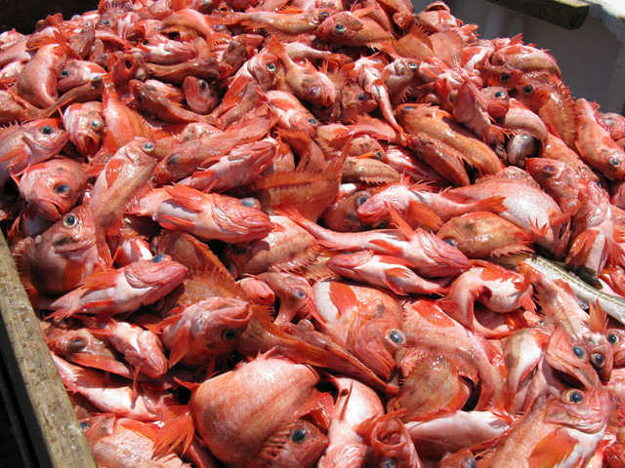
Acadian Redfish
Total Catch (1943-2014)
Source: NOAA

Slide 25
Acadian Redfish
Abundance Indices (1962 to 2015)
Source: NOAA

Slide 26
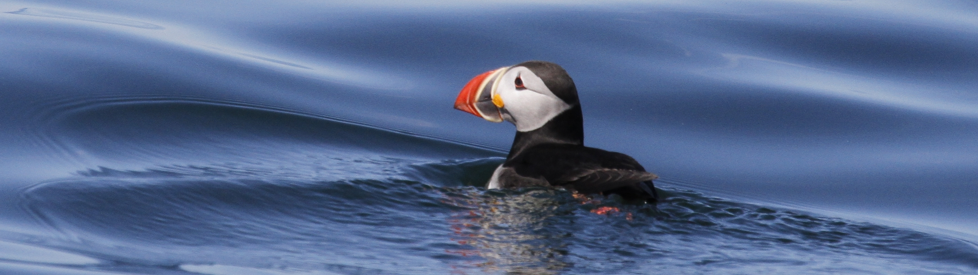


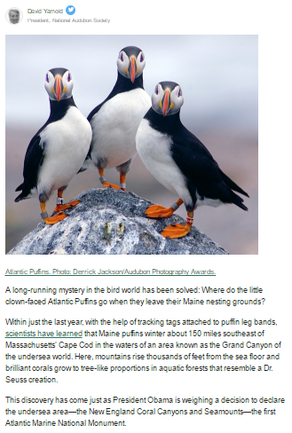
Geolocators
  Led to discovery of winter home of Maine Puffins
  Campaign for National Monument
  20,500 letters to President Obama
  Huffington Post Op Ed from David Yarnold

Slide 27
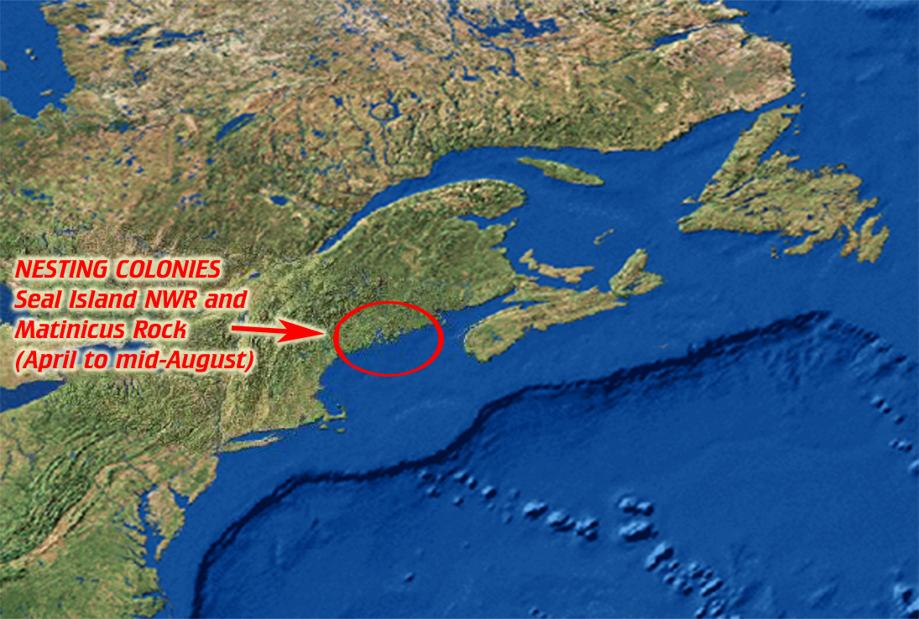

Slide 28
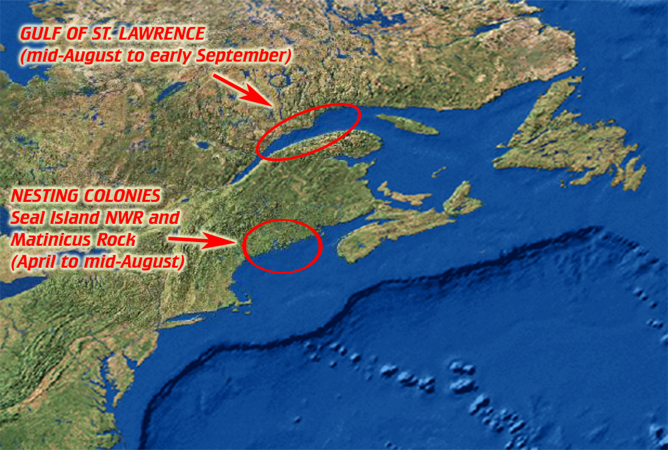

Slide 29
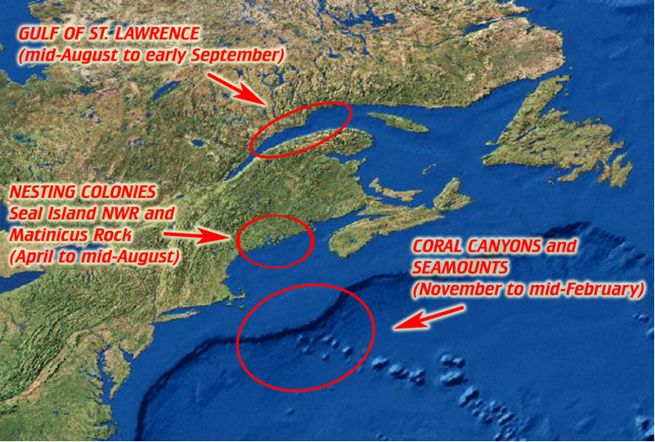

Slide 30
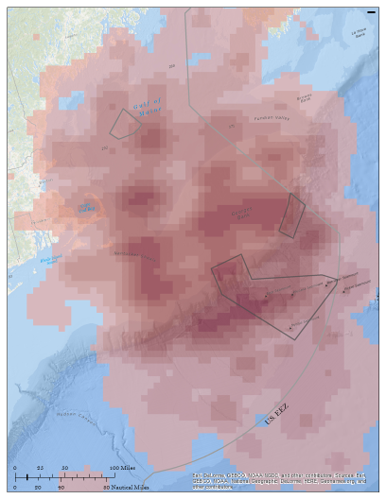
Winter Puffin concentrations
Puffins in winter congregate over the edge of the continental shelf and other banks where they find upwellings.Dark pink indicates areas of frequent use.

Slide 31
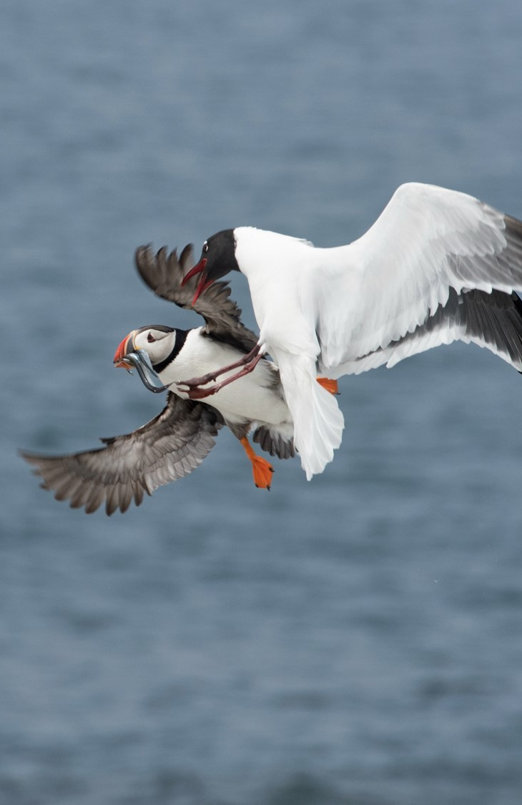
Predation
  Gulls: Continued problem with large gulls, laughing gulls where nesting adjacent
  Night-herons: On two islands, with night stints on Stratton Island developed to mitigate
  Eagle: Predation on Hog Island and on research islands
  Other Raptors:
    Peregrine and Merlin predation noted on several islands.
    Owl absence this year on Pond Island is 1st since program start in 2006.
  Racoon: Made unusual appearance on Seal Island Nat’l Wildlife Refuge
  Mink: Removed on Outer Green & Jenny islands. Observed late at Stratton.

Slide 32
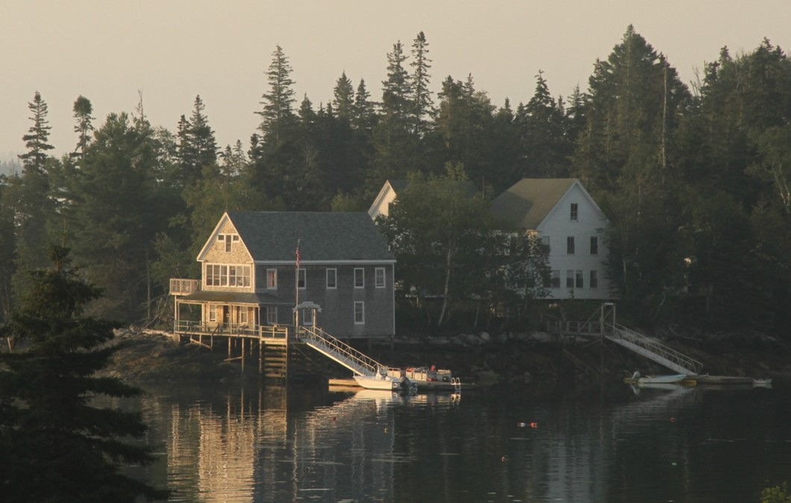
Our Outreach
2016 Highlights

Slide 33
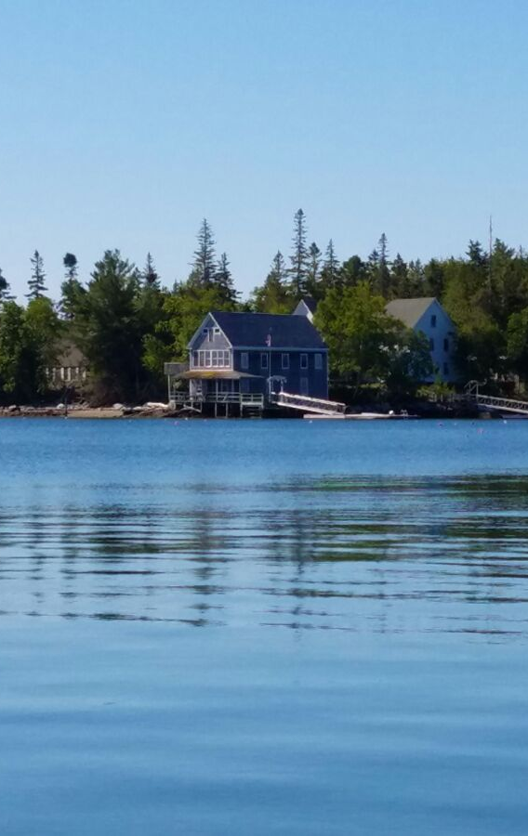
Hog Island: Program Highlights
  Eleven weeks of programs and 15 camp sessions.
  84% capacity and 10% increase in tuition.
  Highest enrollment since SRP began managing with 425 participants
  52 scholarships provided, 12 of which were diversity recipients
  NAS Diversity and Inclusion Summit (40 participants)
  Four Artists-in-Residence
  80th Anniversary Celebration
  NEW Tropical Ornithology Teen Program: December 2016

Slide 35
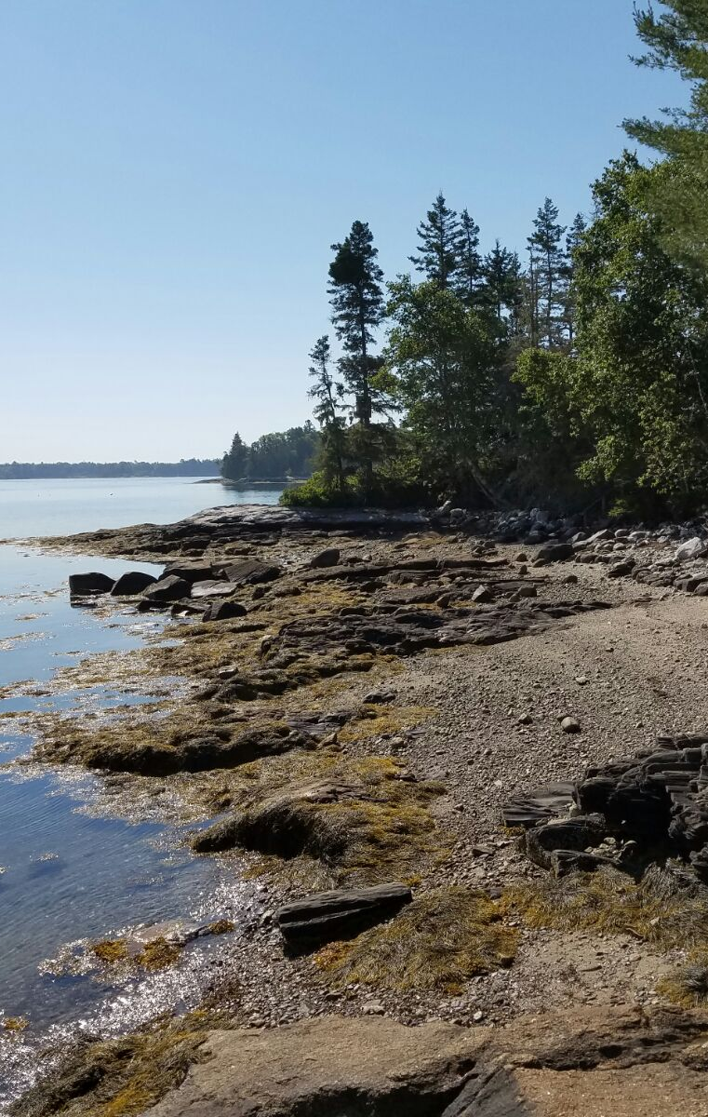
Hog Island: Facility and Sanctuary Highlights
  Conservation easement with Main Coast Heritage Trust
  New mainland pier construction
  New mainland Todd Wildlife Sanctuary sign
  Mainland buildings: energy efficient windows, bathrooms, insulation
  Hog Island buildings: windows, shower upgrades, propane manifold and distribution system
  New roofs on Hog Island: Bridge and Fish House
  Three upgraded Hog Island rooms with private bathrooms
  New solar arrays will provide 70-95% of electric needs

Slide 36
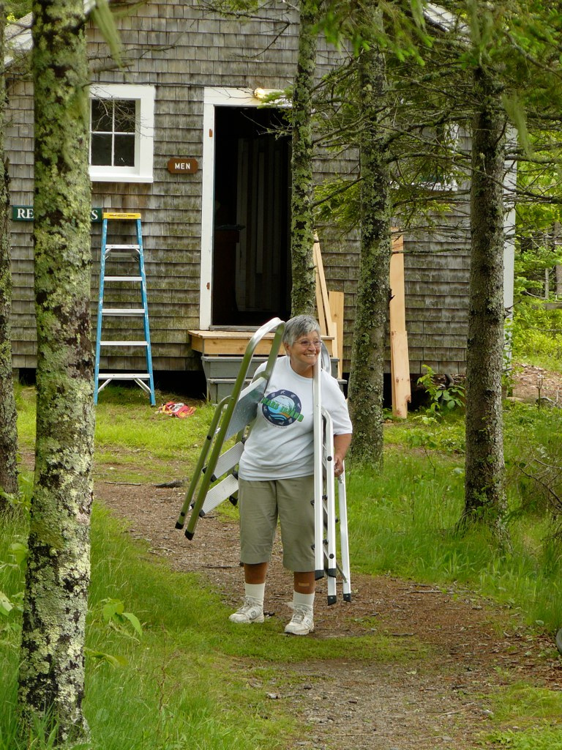
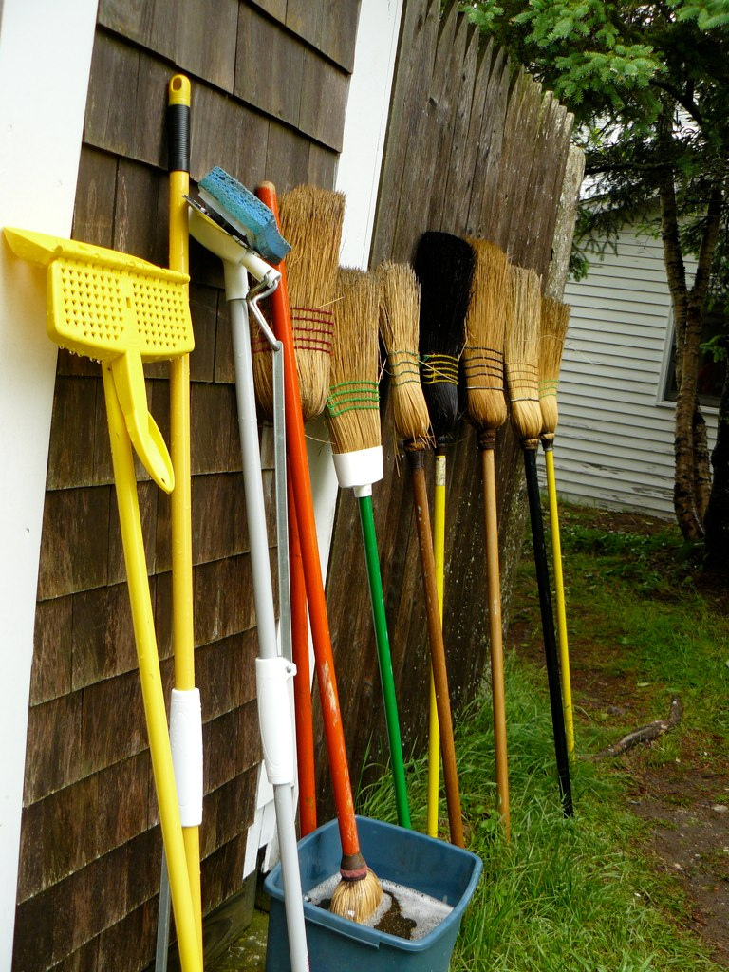
Friends of Hog Island (FOHI)
  Total of 96 volunteers for 4,362 hours => $92,474 in labor donated
  Annual contribution of $50,000. MCHT Easement stewardship fee $15,000
  Solar panels on Fish House: $24,500.00 to be installed
  Propane manifold system donation for kitchen propane tanks
  New compost process through FOHI with Lincoln County Recycling Center
  Partnership with Old Bristol Garden Club to maintain gardens and window boxes
  72 sets of new bed linens
  Archive project: digitalizing and categorizing Hog Island archive

Slide 37
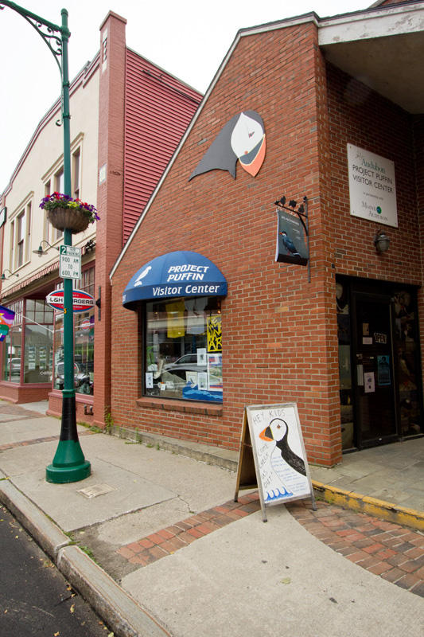
Project Puffin Visitor Center
  Summer Weekly Education Programs for kids
  Year-Round Bi-Weekly Education Programs for kids
  Community Outreach Presentations
  Annual Art Exhibit Rotation
  Summer Wednesday Night Lecture series
  Participation in Community Events
    Summer Solstice Celebration
    Lobster Festival
    Maine, Boats, Home and Harbor Show
    Camden Wind Jammer Festival
    Festival of Lights Parade
    Pies On Parade

Slide 38
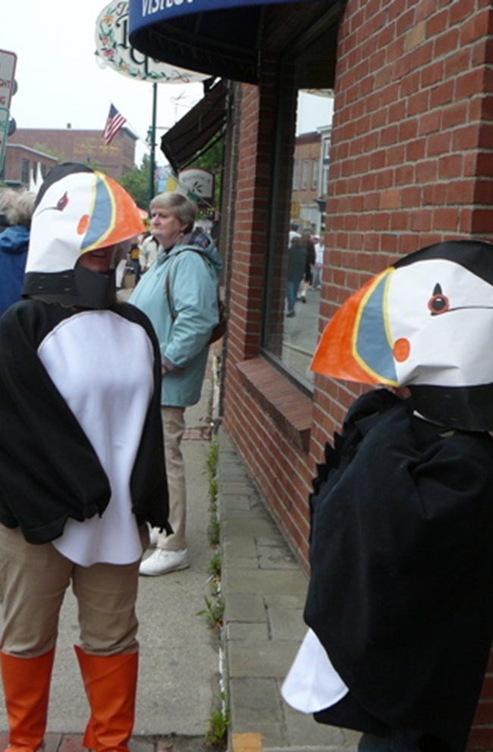

Slide 39
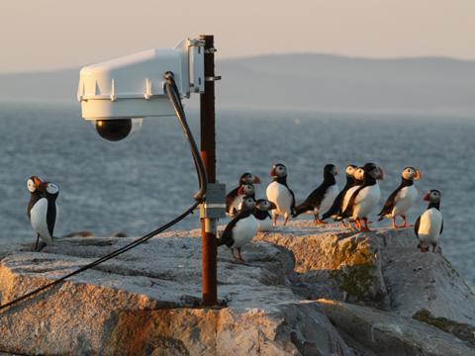
Explore.org Cams
  7.7 M Total Views in 2015
    3.8M Explore.org
    3.9 M view on YouTube
    953,798 hours YouTube view time
    Viewed in over 200 countries
  Includes
    Osprey Nest
    Puffin Burrow
    Puffin Loafing Ledge
    Boulder Berm
    Guillemot Burrow
    Double Crested Cormorant Cam installed, Spring 2016

Slide 40
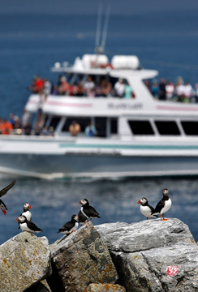
Boat Tours
Narrated 45 boat tours from Boothbay Harbor reaching an audience of 4479 passengers.
Boothbay program had a 35% increase in tours and 20% increase in passengers over 2015.
Narrated approx. 65 boat tours from New Harbor to date, reaching an estimated audience of 4500.
School Outreach
Schools, Project Puffin Visitor Center, and Nature Center Programs continue to reach youth and adults

Slide 41
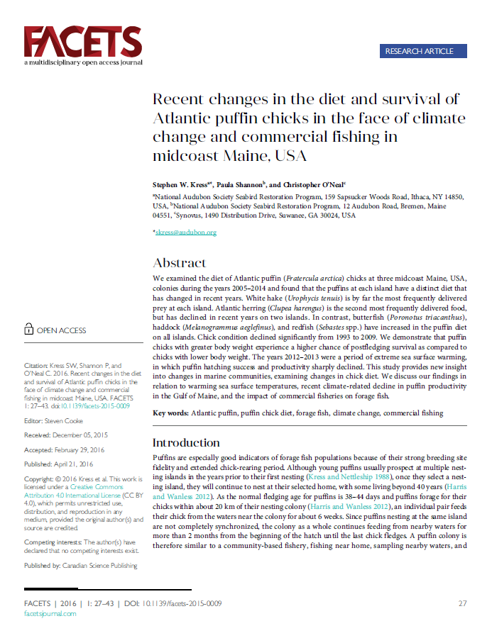
Papers and Presentations
  2nd World Seabird Conference- Cape Town SA
  Pacific Seabird Group, Oahu, HA
  International Marine Conservation Congress, St. John’s, Newfoundland
  13 Birding Festivals and special events

Slide 42
Financial Report 2015-2016
Seabird Restoration Program

Slide 44
Seabird Restoration Program
Income Statement (FY16 Preliminary)
Description | FY14 Total | FY15 Total | FY16 Total |  | FY16 Dept Seabird | FY16 Dept PPVC | FY16 Dept Hog Island
Contributions | 918,694 | 1,003,923 | 993,165 |  | 875,036 | 34,043 | 84,086
Government Grants | 99,830 | 47,076 | 78,027 |  | 78,027 | 0 | 0
Departmental Revenue Transfers | (7,415) | (21,850) | (24,339) |  | 66,866 | 7,500 | (98,705)
Investment Income | 200,610 | 70,610 | 73,764 |  | 73,757 | 7 | 0
Earned Income | 447,079 | 506,877 | 558,140 |  | 24,694 | 58,615 | 474,831
Total Revenue | 1,658,798 | 1,606,636 | 1,678,757 |  | 1,118,380 | 100,165 | 460,212
Salaries | 693,477 | 613,850 | 617,997 |  | 458,787 | 43,112 | 116,098
Payroll Taxes & Benefits | 171,305 | 153,712 | 174,989 |  | 138,350 | 14,019 | 22,620
Travel & Meetings | 34,328 | 32,484 | 44,691 |  | 24,744 | 100 | 19,847
Postage and Mailing | 28,284 | 31,569 | 26,612 |  | 24,427 | 543 | 1,642
Scholarships and Grants | 1,601 | 18,429 | 7,506 |  | 7,450 | 12 | 44
Professional Services | 113,247 | 140,637 | 146,702 |  | 79,033 | 0 | 67,669
Occupancy | 65,478 | 57,701 | 57,156 |  | 24,024 | 20,100 | 13,032
Telecommunications | 35,126 | 24,242 | 29,214 |  | 26,470 | 811 | 1,933
Insurance | 28,171 | 25,064 | 24,000 |  | 16,397 | 1,173 | 6,430
Fees | 37,874 | 17,542 | 36,979 |  | 10,234 | 6,167 | 20,578
Depreciation | 3,416 | 189 | 0
Direct Mail, Marketing & Other Printing | 24,358 | 26,065 | 27,270 |  | 23,039 | 2,689 | 1,542
Repairs and Maintenance | 38,785 | 21,317 | 15,844 |  | 12,131 | 0 | 3,713
Supplies | 36,852 | 44,242 | 48,136 |  | 26,011 | 2,552 | 19,573
Center and Education Expenses | 107,585 | 101,826 | 68,110 |  | 31,605 | 71 | 36,434
Transfers | 0 | (65,000) | (9,258) |  | (68) | 0 | (9,190)
Expenses Excl SSA | 1,419,887 | 1,243,869 | 1,315,948 |  | 902,634 | 91,349 | 321,965
Support Services/Contingency | 221,912 | 196,431 | 197,759 |  | 146,812 | 13,796 | 37,151
Total Expenses | 1,641,799 | 1,440,300 | 1,513,707 |  | 1,049,446 | 105,145 | 359,116
 |  | Surplus to Reserves
Net Income (Expense) | 16,999 | 166,336 | 165,050 |  | 68,934 | (4,980) | 101,096

Slide 45
Take home points from FY16 Budget
Three SRP cost centers (Seabirds, Hog Island and Project Puffin Visitor Center) showed similar revenue as previous recent years.
The FY16 budget had a surplus of $165,050 which will be put into the restricted ‘operating reserves’ fund that now totals $373,892.39. These funds can be used only for SRP cost centers.

Slide 46
“Puffin Society” formed

Slide 47
Feasibility & Planning Update
Seabird Restoration Program

Slide 48
CCS Essential questions to be clarified
  What role will National Audubon Society have in supporting the campaign and the Audubon Seabird Institute?
  What are the short- and mid-term goals for the Institute? Is the geographic scope regional or national?
  What steps will be taken to develop a succession plan for Dr. Kress?
  What role will Hog Island have in the Institute and in the campaign?
  Who is leading the proposed campaign, and have lead prospects been identified?

Slide 49
CCS Recommendations
  Provide immediate clarity to the need for greater organizational structure in the proposed Audubon Seabird Institute.
  Develop a sharpened Case, emphasizing a clear mission and specific focus.
  Prepare a comprehensive funding mix with a first benchmark of $2.5M; adopt a phased approach to reach a preliminary goal of $5M.
  Secure volunteer leaders to assist in preparation and execution of the campaign.
  Prioritize the identification and cultivation of new potential supporters.
  Allocate necessary resources to staff and manage the campaign.
  Engage an Advisory Council for the proposed Audubon Seabird Institute.
  Develop and Planned Giving program to build endowment.

Slide 50
Executive Director
Steve Kress
Managing Director
Tiffany Huenefeldt
Science Director
TBD
Associate Director
Rosalie Borzik
Education Director /
Hog Island
TBD
Sanctuary Manager
Paula Shannon
Assistant Sanctuary Manager
Susan Schubel
Island Supervisors
Seasonal
Research Assistants
Seasonal
Fellows
Seasonal
Research Volunteers
Seasonal
Office Manager
Deborah Wood
Giving Manager
Ruth Likowski
Hog Island Facilities Manager
Eric Snyder
PPVC Visitor Center Manager
Susan Meadows
Boat Tour Coordinator
Pete Salmansohn
Maintenance Assistant
Adrian Bregy
Artist in Residence Coordinator
Sherry York
School Outreach Teacher
Susan Schubel
Head Chef
Cleo Bell
Assistant Chef
Kristen Bokros
Kitchen Assistant
Eli Redfern
Education Interns
Seasonal
PPVC Assistant Manager
Seasonal
Social Media
Terry Mingle
Hog Island Program Manager
Eva Matthews
Hog Island Session Directors, Instructors and FOHI Volunteers
Varies
Draft ASI Organization Chart
Seabird Institute Advisory Board
Friends of Hog Island
Conservation Leadership
Science
Education
Operations

Slide 51
Audubon Seabird Institute
  Formed as the focal point for Audubon Seabird conservation within the Coasts Program.
  Collaborates with marine and other seabird groups to further global knowledge.
  Based in Maine, but embraces bi-coastal science and solutions in protecting seabirds.
  Education and outreach through speaking engagements, project collaboration, Hog Island Audubon Camp, Project Puffin Visitor’s Center, and International Intern Program.
COASTS
Audubon Seabird Institute
READINESS
CAPACITY
RESULTS

Slide 52
Questions?
Seabird Restoration Program

Slide 53
Key Take-Aways
  Continued presence on islands remains critical to seabird success.
  Ocean temperatures and health of forage fisheries are critical issues for seabird success.
  Seabird Restoration Program is financially healthy with a diversified revenue stream.
  The components of Science and Outreach work well and can grow through careful collaboration.
  Seabird Restoration Program is a cornerstone of seabird management within National Audubon’s Coasts program.

Slide 54
Our Seabird Science
2016 Findings

